Slide 1
Chapter 4
Processor Design - Pipelining

Slide 2
The concept of pipelining is not new It had been in practice in industrial assembly-lines (e.g., automobiles) for a long time

Slide 3
Job: Manufacture n cars
Description
Multiple phases are needed to complete production;
Each phase needs specific expertise/
instruments/time
Goal: How to optimize the total completion time (cost) for producing n cars

Slide 4
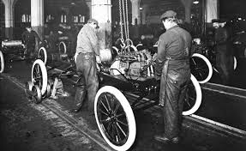
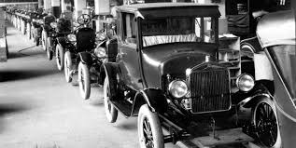
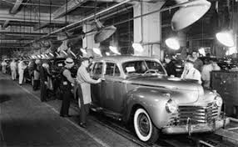
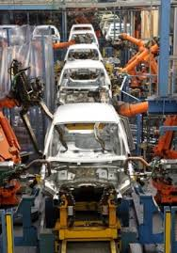
Assembly Line
Basic Idea
Car is moved through different stations (phases)
sequentially comprising relevant workforce
A specific sub-task is performed in each station
Multiple stations are busy at any time instance
(sub-tasks overlapped in time)
Each station performs only one specific job
every time (non-overlapped in space)
Certain precedence among tasks should be honored
Phases should preferably be balanced in time

Slide 5
Recap: Single-Cycle Processor Design

Slide 6
von Neumann Architecture (1945): Princeton Architecture
Stored program concept
Serves as the basis for almost all modern computers
Instructions and data are just bits
Programs (sequence of machine instructions) are stored in memory to be read or written just like data
Registers
memory for data, programs,
compilers, systems programs
Processor
Memory
PC
Fetch & Execute Cycle
Program Counter (PC) points to the present Instruction to be fetched
Bits in the register "control" the subsequent actions
Fetch the “next” instruction and continue

Slide 7
Execution Cycle (MIPS)
Obtain instruction from memory (IF)
Instruction
Fetch
Instruction
Decode
Instruction-Decode and Register-Read (ID/RR)
Execute
Execute the instruction (Ex)
Memory Access
Locate and obtain operand data from memory/register (Mem)
Result
Store
Write-Back results in register/memory for later use (WB)
Next
Instruction
Determine successor instruction
IF → ID/RR → EX → Mem → WB

Slide 8
MIPS Instruction Subset
31
26
21
16
11
6
0
op
rs
rt
rd
shamt
funct
R-type
add rd, rs, rt
sub, and, or, slt
LOAD and STORE
lw rt, rs, imm
sw rt, rs, imm
BRANCH:
beq rs, rt, imm
6 bits
5 bits
5 bits
5 bits
5 bits
6 bits
Read registers rs and rt
Feed them to ALU
Update register file
31
26
21
16
0
op
rs
rt
immediate
6 bits
5 bits
5 bits
16 bits
Read register rs (and rt for store)
Feed rs and immed to ALU
Move data between mem and reg
31
26
21
16
0
op
rs
rt
displacement
6 bits
5 bits
5 bits
16 bits
Read registers rs and rt
Feed to ALU to compare
Add PC to disp; update PC

Slide 9
Datapath for Reg-Reg Operations
R[rd] <- R[rs] op R[rt] Example: add rd, rs, rt
ID’s of three registers obtained from rs, rt, and rd fields of the instruction (two sources and one destination)
ALU-operation signal depends on op and funct
31
26
21
16
11
6
0
op
rs
rt
rd
shamt
funct
6 bits
5 bits
5 bits
5 bits
5 bits
6 bits

Slide 10
Datapath for Load Operations
R[rt] <- Mem[R[rs] + SignExt[imm16]] Example: lw rt, rs, imm16
31
26
21
16
0
op
rs
rt
immediate
6 bits
5 bits
5 bits
16 bits

Slide 11
Datapath for Store Operations
Mem[R[rs] + SignExt[imm16]] <- R[rt] Example: sw rt, rs, imm16
31
26
21
16
0
op
rs
rt
immediate
6 bits
5 bits
5 bits
16 bits

Slide 12
Composing the Elements
Execute an instruction in one clock cycle
Each datapath element can only do one function at a time
Hence, we need separate instruction and data memories
Use multiplexers where alternate data sources are used for different instructions

Slide 13
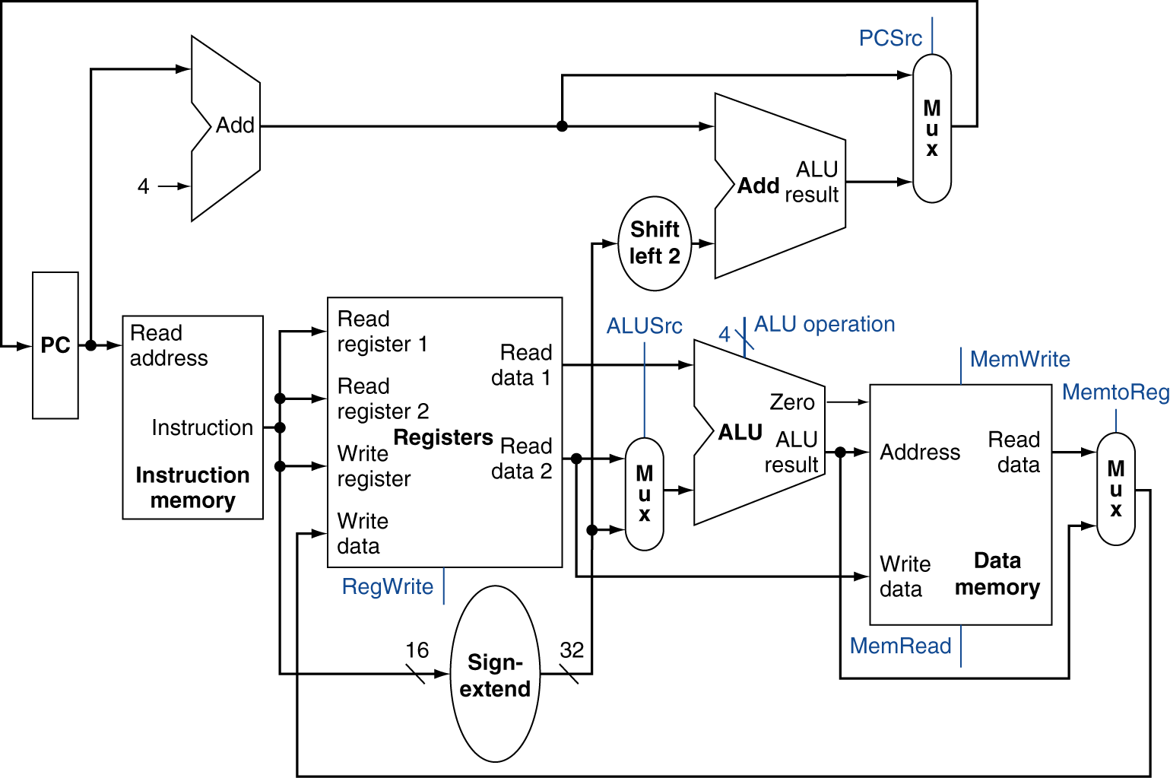
Full Datapath

Slide 14
All together: the single cycle datapath

Slide 15
The R-Format (e.g. add) Datapath
Need ALUsrc=1, ALUop=“add”, MemWrite=0, MemToReg=0,
RegDst = 0, RegWrite=1 and PCsrc=1.

Slide 16
The Load Datapath
What control signals do we need for load??

Slide 17
The Store Datapath

Slide 18
The beq Datapath

Slide 19
Control Signal Requirement

Slide 20
Control
Selecting the operations to perform (ALU, read/write, etc.)
Controlling the flow of data (multiplexor inputs)
Information comes from the 32 bits of the instruction
Example: add $8, $17, $18 Instruction Format: 000000 10001 10010 01000 00000 100000 op rs rt rd shamt funct
ALU's operation based on instruction type and function code

Slide 21
ALU Control
ALU used for
Load/Store: F = add
Branch: F = subtract
R-type: F depends on funct field
§4.4 A Simple Implementation Scheme
ALU control | Function
0000 | AND
0001 | OR
0010 | add
0110 | subtract
0111 | set-on-less-than
1100 | NOR

Slide 22
ALU Control
Assume 2-bit ALUOp derived from opcode
Combinational logic derives ALU control
opcode | ALUOp | Operation | funct | ALU function | ALU control
lw | 00 | load word | XXXXXX | add | 0010
sw | 00 | store word | XXXXXX | add | 0010
beq | 01 | branch equal | XXXXXX | subtract | 0110
R-type | 10 | add | 100000 | add | 0010
 |  | subtract | 100010 | subtract | 0110
 |  | AND | 100100 | AND | 0000
 |  | OR | 100101 | OR | 0001
 |  | set-on-less-than | 101010 | set-on-less-than | 0111

Slide 23
The Main Control Unit
Control signals derived from instruction
R-type
0
rs
rt
rd
shamt
funct
31:26
25:21
20:16
15:11
10:6
5:0
Load/ Store
35 or 43
rs
rt
address
31:26
25:21
20:16
15:0
Branch
4
rs
rt
address
31:26
25:21
20:16
15:0
opcode
always read
read, except for load
write for R-type and load
sign-extend and add

Slide 24
Control
Simple combinational logic (truth tables)

Slide 25
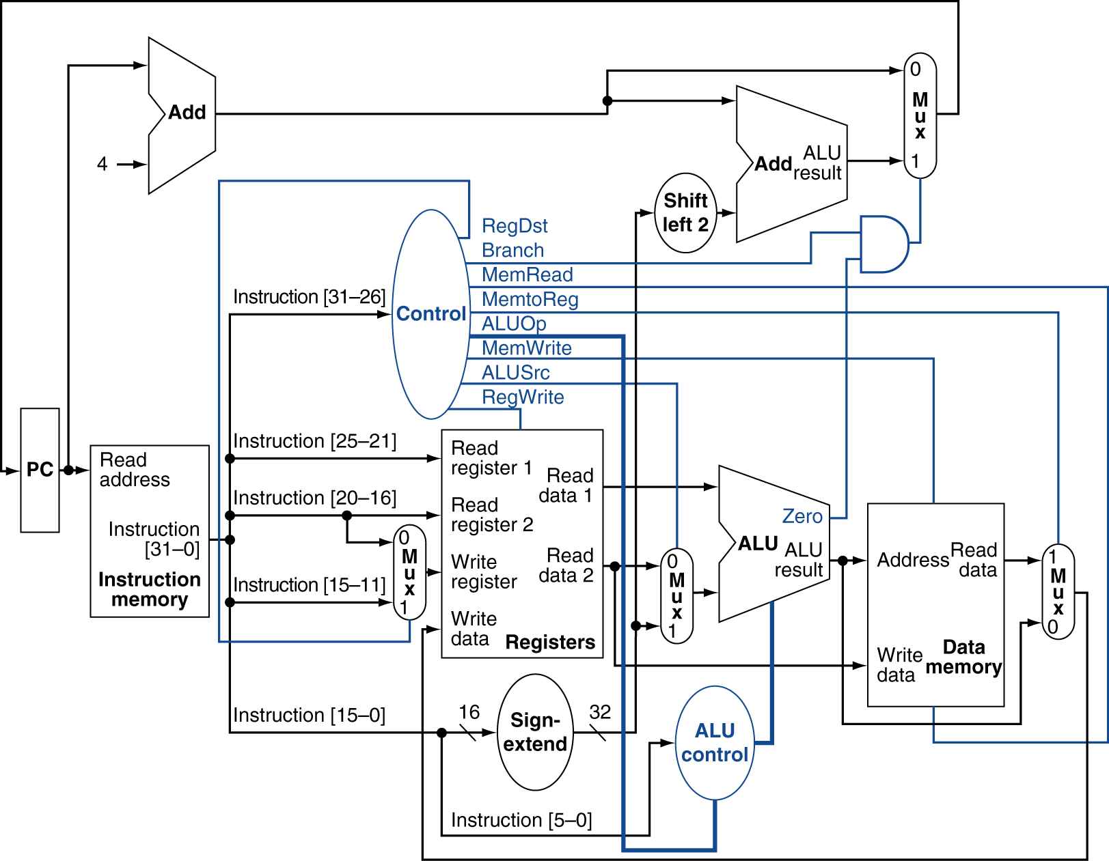
Datapath With Control
Instruction
Fetch
Instr. Decode
Reg. Fetch
Execute
Addr. Calc
Memory
Access
Write
Back
IF → ID/RR → EX → Mem → WB

Slide 26
Datapath With Control

Slide 27
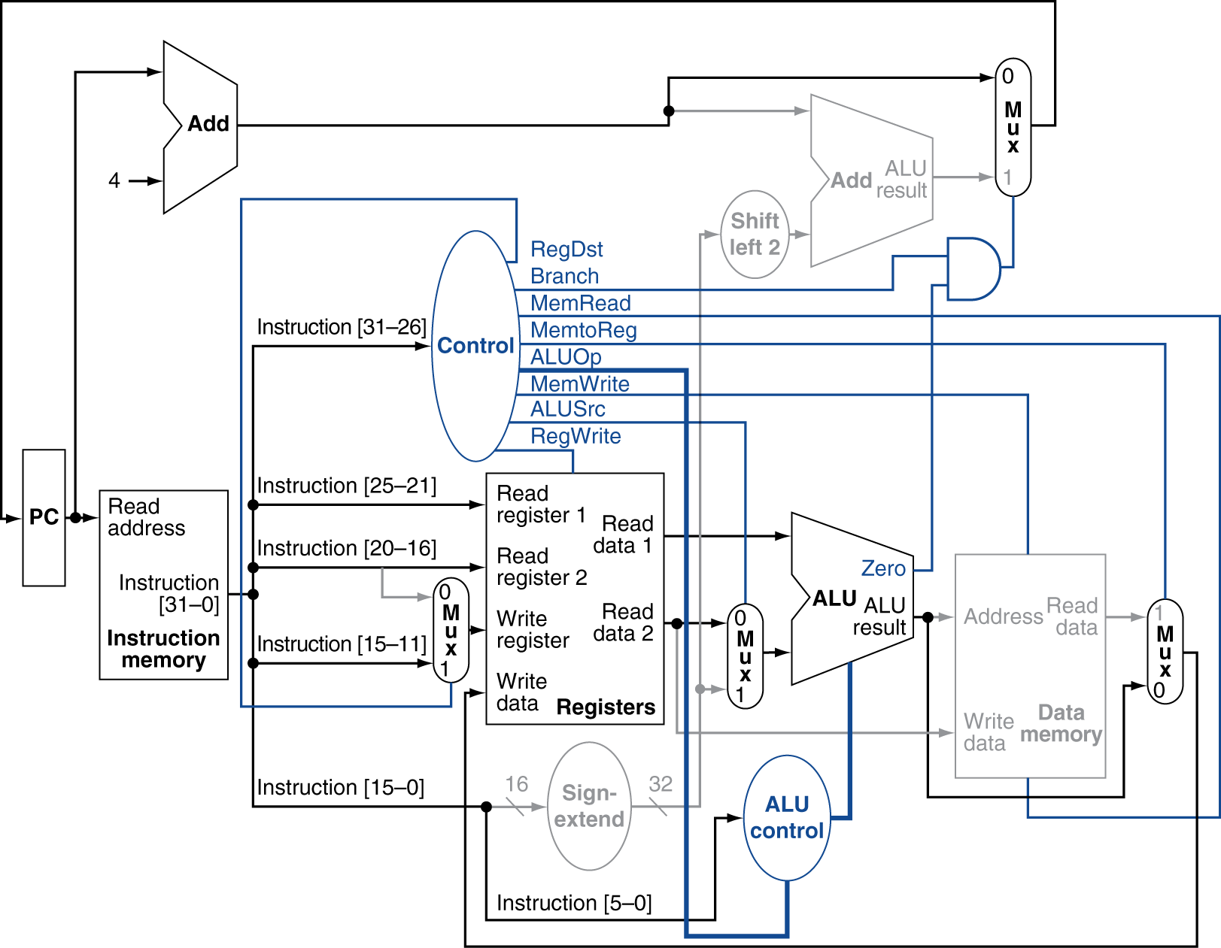
R-Type Instruction

Slide 28
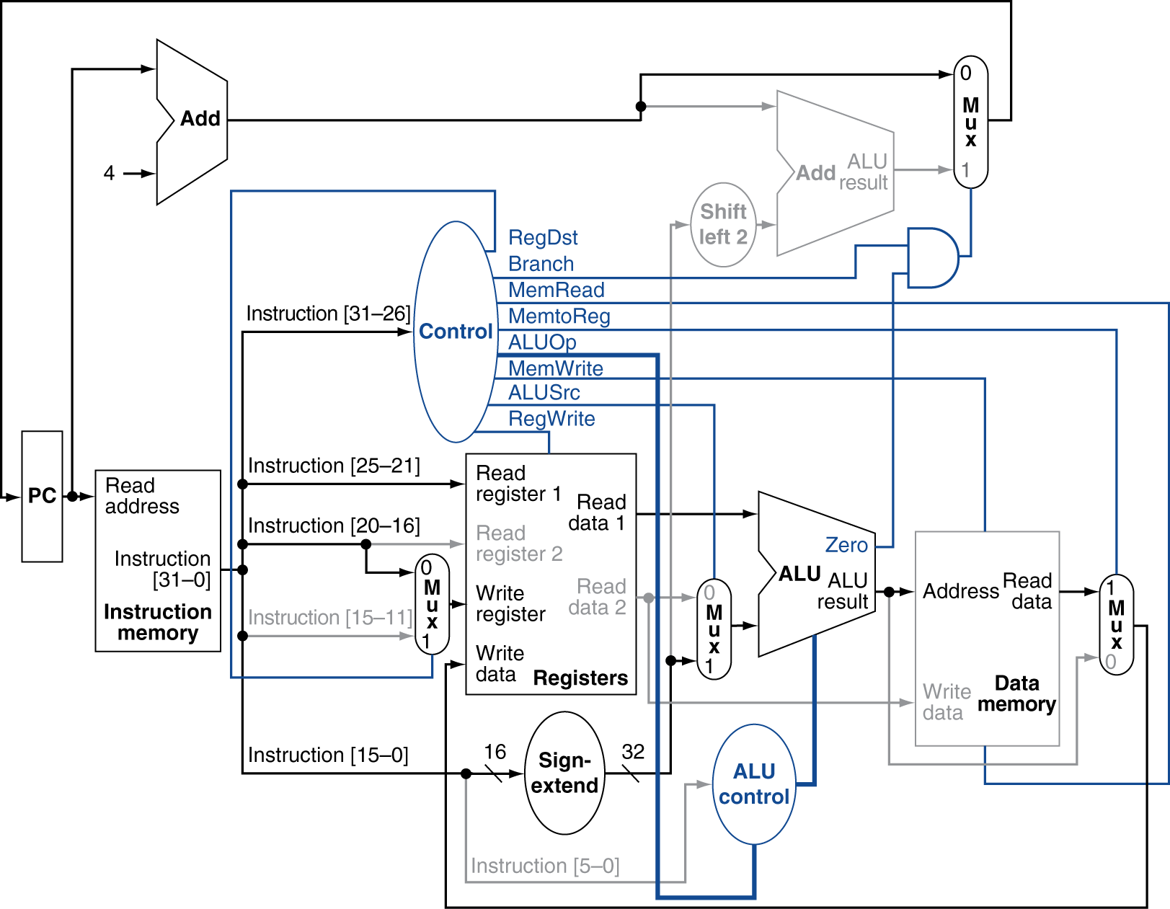
Load Instruction

Slide 29
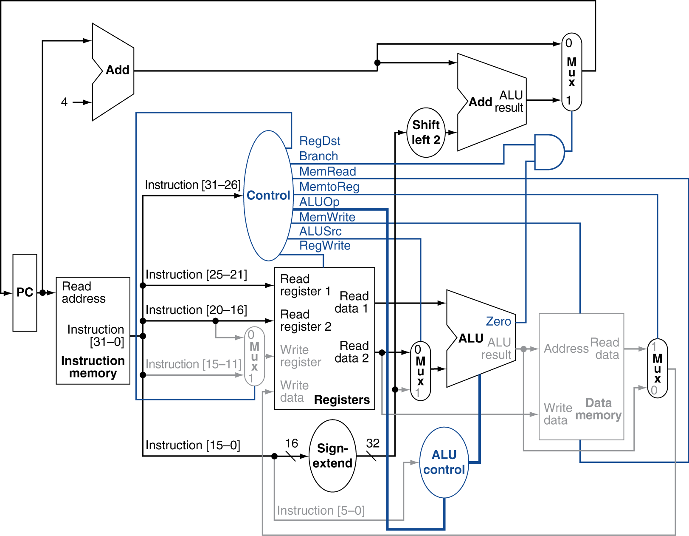
Branch-on-Equal Instruction

Slide 30
Implementing Jumps
Jump
2
address
31:26
25:0
Jump uses word address
Update PC with concatenation of
Top 4 bits of old PC
26-bit jump address
00
Need an extra control signal decoded from opcode

Slide 31
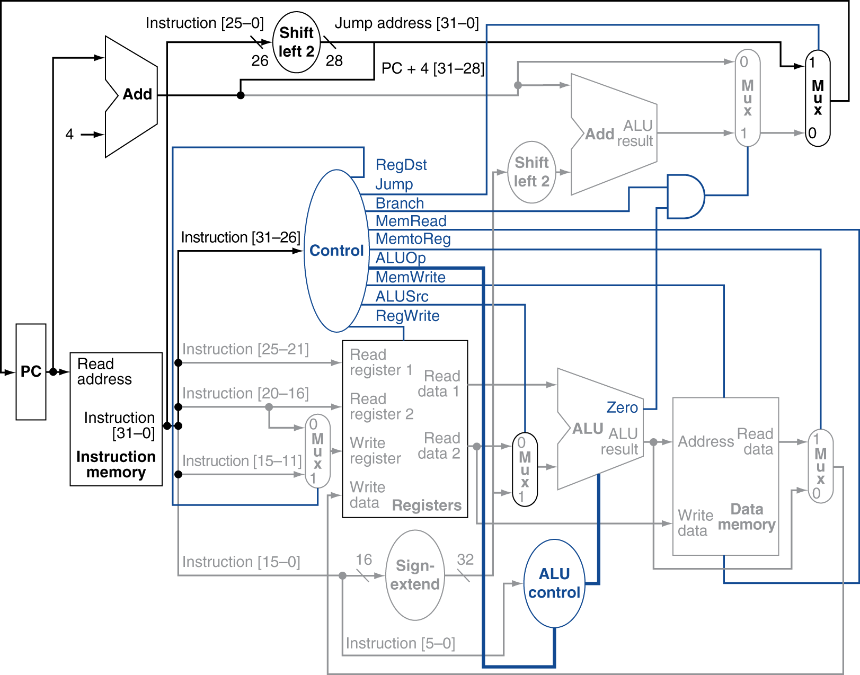
Datapath With Jumps Added
IF → ID/RR → EX → Mem → WB

Slide 32
Performance Issues
Longest delay determines clock period
Critical path: load instruction
Instruction memory → register file → ALU → data memory → register file
Not feasible to vary period for different instructions
Violates design principle
Making the common case fast
We will improve performance by pipelining

Slide 33
Key Points
CPU is just a collection of state and combinational logic
We have just designed a processor, at least in terms of functionality
CPU time = IC * CPI * CCT
single-cycle machine degrades performance
Needs improved techniques such as pipelining

Slide 34
Goal of Pipelining
CPU-time = IC * CPI * CCT
How to reduce CPU-time??
Improvement due to pipelining can be viewed as from two perspectives
Reduces effective CCT (for single-cycle CPUs)
Reduces CPI (for multi-cycle CPUs)

Slide 35
What Is Pipelining
Laundry Example
Four users A, B, C, D each have one load of clothes to wash, dry, and fold
Washer takes 30 minutes
Dryer takes 40 minutes
Folder takes 20 minutes
A
B
C
D

Slide 36
What Is Pipelining: Laundry Example
6 PM
7
8
9
11
Midnight
Only one resource is busy at a time
10
Time (in minutes)
30
40
20
30
40
20
30
40
20
30
40
20
T
a
s
k
O
r
d
e
r
A
Washer is idle
B
C
washing 30 mins
drying 40 mins
folding 20 mins
Total: 90 mins
D
Sequential laundry takes 6 hours for four users; Work finishes at 00:00
If they learned pipelining, how long would laundry take?

Slide 37
Basic Idea of Pipelining
Minimize idle-time for resources
multiple resources overlapped in time
6 PM
7
8
9
10
11
Midnight
Time
30
40
40
40
40
20
T
a
s
k
O
r
d
e
r
A
Pipelined laundry takes 3.5 hours for 4 loads
Speed-up = 6/3.5 = 1.714
Speed-up when n → ∞
= 90/40 = 2.25
< 3 (number of pipe-stages)
B
C
D

Slide 38
Impact of Pipeline Stages
6 PM
7
8
9
10
11
Midnight
Time
30
40
20
T
a
s
k
O
r
d
e
r
40
Q1. What is the time difference between two consecutive finish-times?
time required to move an instruction one step forward
→ longest time (slowest) among pipe-stages
A
B
Q2. What is the maximum speed-up compared to
non-pipelined approach??
→ limited by the number of pipe-stages

Slide 39
Pipelining Lessons
What Is Pipelining
6 PM
7
8
9
Pipelining doesn’t help latency of single task, it helps throughput of entire workload
Pipeline rate limited by slowest pipeline stage
Multiple tasks operating simultaneously
Potential speed-up < Number pipe stages (pipe-depth)
Unbalanced lengths of pipe stages reduces speed-up
Time to “fill” pipeline and time to “drain” it reduces speedup
Stall for Dependences
Time
T
a
s
k
O
r
d
e
r
30
40
40
40
40
20
A
B
C
D

Slide 40
Learned So Far ….
Pipelining is widely used in modern processors.
Pipelining improves system performance in terms of throughput.
Pipelined organization requires sophisticated compilation techniques.

Slide 41
Making the Execution of Programs Faster
Arrange the hardware so that more than one operation can be overlapped at the same time.
The number of operations performed per second is increased even though the elapsed time needed to perform any one operation is not changed.

Slide 42
Recap: Pipelined Processor Design

Slide 43
Pipelining Lessons
What Is Pipelining
6 PM
7
8
9
Pipelining doesn’t help latency of single task, it helps throughput of entire workload
Pipeline rate limited by slowest pipeline stage
Multiple tasks operating simultaneously
Potential speed-up < Number pipe stages (pipe-depth)
Unbalanced lengths of pipe stages reduces speed-up
Time to “fill” pipeline and time to “drain” it reduces speedup
Stall for Dependences
Time
T
a
s
k
O
r
d
e
r
30
40
40
40
40
20
A
B
C
D

Slide 44
MIPS Pipeline
Five stages, one step per stage
IF: Instruction fetch from memory
ID/RR: Instruction decode & register read
EX: Execute operation or calculate address
MEM: Access memory operand
WB: Write result back to register

Slide 45
Datapath With Control
Instruction
Fetch
Instr. Decode
Reg. Fetch
Execute
Addr. Calc
Memory
Access
Write
Back
IF → ID/RR → EX → Mem → WB

Slide 46
Pipeline Performance
Assume time for stages is
100ps for register read or write
200ps for other stages
Compare pipelined datapath with single-cycle datapath
slowest
Instr | IF | ID/RR | Ex | Mem | Write Back | Total time
lw | 200ps | 100 ps | 200ps | 200ps | 100 ps | 800ps
sw | 200ps | 100 ps | 200ps | 200ps |  | 700ps
R-format | 200ps | 100 ps | 200ps |  | 100 ps | 600ps
beq | 200ps | 100 ps | 200ps |  |  | 500ps

Slide 47
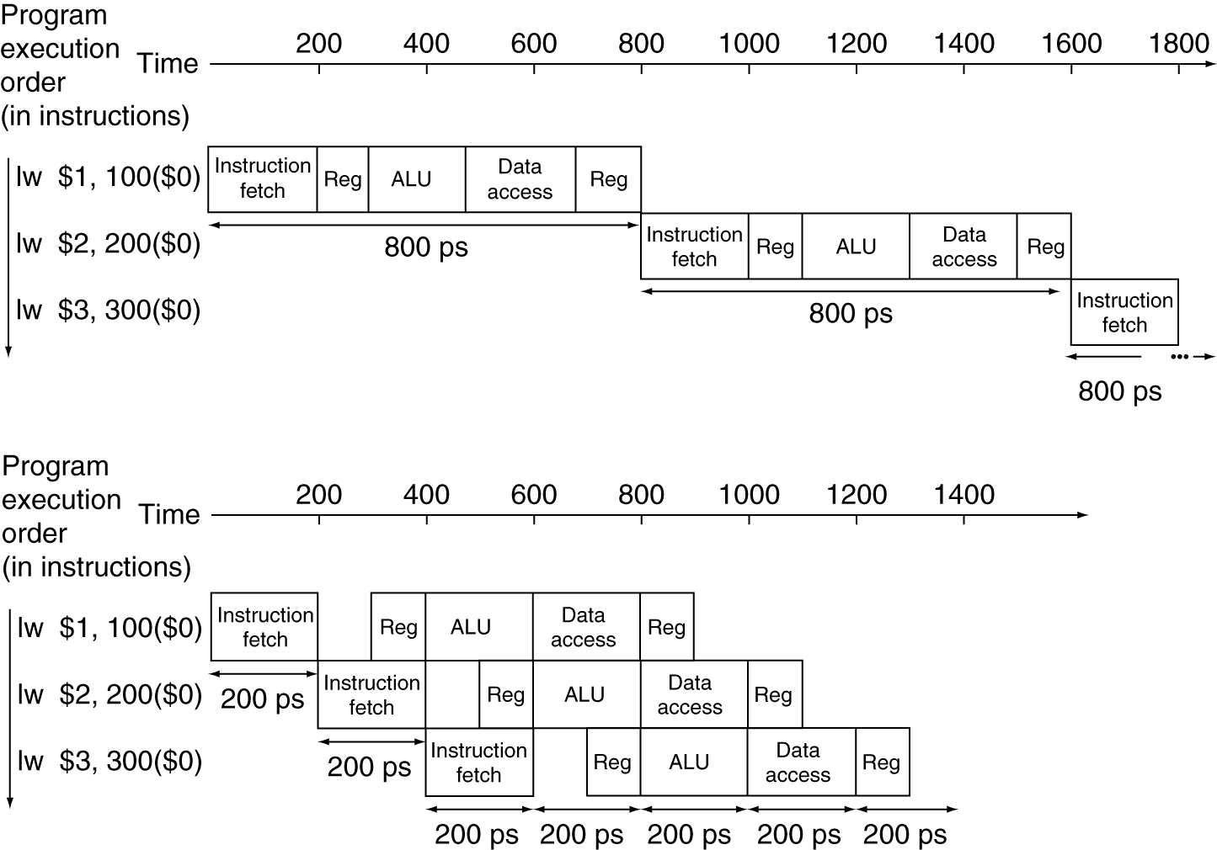
Pipeline Performance
Single-cycle (T_{c}= 800ps)
Pipelined (T_{c}= 200ps)
200 ps
Pipeline overhead?

Slide 48
Multi-Cycle Datapath: 5 stages
Each stage has its own functional units.
Each stage can execute in 2ns
Just like the multi-cycle implementation
IF
ID/RR
EX
MEM
WB
RegWrite
Read
address
Instruction
[31-0]
I [25 - 21]
MemWrite
MemToReg
Read
register 1
Read
data 1
I [20 - 16]
ALU
Read
address
Read
data
1
M
u
x
0
Instruction
memory
Read
register 2
Zero
0
M
u
x
1
Read
data 2
0
M
u
x
1
Result
Write
address
Write
register
Data
memory
Registers
Write
data
I [15 - 11]
Write
data
ALUOp
ALUSrc
MemRead
RegDst
I [15 - 0]
Sign
extend
2ns
2ns
2ns
2ns

Slide 49
A pipeline diagram
 | Clock cycle (time)
 | 1 | 2 | 3 | 4 | 5 | 6 | 7 | 8 | 9
lw $t0, 4($sp) | IF | ID | EX | MEM | WB
sub $v0, $a0, $a1 |  | IF | ID | EX | MEM | WB
and $t1, $t2, $t3 |  |  | IF | ID | EX | MEM | WB
or $s0, $s1, $s2 |  |  |  | IF | ID | EX | MEM | WB
add $sp, $sp, -4 |  |  |  |  | IF | ID | EX | MEM | WB
A pipeline diagram shows the execution of a series of instructions.
The instruction sequence is shown vertically, from top to bottom.
Clock cycles are shown horizontally, from left to right.
Each instruction is divided into its component stages. (We show five stages for every instruction, which will make the control unit easier.)
Note overlapping of instructions. For example, there are three instructions active in the third cycle above.
The “lw” instruction is in its Execute stage.
Simultaneously, the “sub” is in its Instruction Decode stage.
Also, the “and” instruction is just being fetched.

Slide 50
Pipeline terminology
 | Clock cycle
 | 1 | 2 | 3 | 4 | 5 | 6 | 7 | 8 | 9
lw $t0, 4($sp) | IF | ID | EX | MEM | WB
sub $v0, $a0, $a1 |  | IF | ID | EX | MEM | WB
and $t1, $t2, $t3 |  |  | IF | ID | EX | MEM | WB
or $s0, $s1, $s2 |  |  |  | IF | ID | EX | MEM | WB
add $sp, $sp, -4 |  |  |  |  | IF | ID | EX | MEM | WB
filling
full
emptying
The pipeline depth is the number of stages—in this case, five.
In the first four cycles here, the pipeline is filling, since there are unused functional units.
In cycle 5, the pipeline is full. Five instructions are being executed simultaneously, so all hardware units are in use.
In cycles 6-9, the pipeline is emptying.

Slide 51
Pipeline Datapath: Resource Requirements
 | Clock cycle
 | 1 | 2 | 3 | 4 | 5 | 6 | 7 | 8 | 9
lw $t0, 4($sp) | IF | ID | EX | MEM | WB
lw $t1, 8($sp) |  | IF | ID | EX | MEM | WB
lw $t2, 12($sp) |  |  | IF | ID | EX | MEM | WB
lw $t3, 16($sp) |  |  |  | IF | ID | EX | MEM | WB
lw $t4, 20($sp) |  |  |  |  | IF | ID | EX | MEM | WB
We need to perform several operations in the same cycle.
Increment the PC and add registers at the same time.
Fetch one instruction while another one reads or writes data.
What does this mean for our hardware?

Slide 52
Pipelining Multiple Instruction-Types
R-type instructions only require 4 stages: IF, ID, EX, and WB
We don’t need the MEM stage
What happens if we try to pipeline loads with R-type instructions?
 | Clock cycle
 | 1 | 2 | 3 | 4 | 5 | 6 | 7 | 8 | 9
add $sp, $sp, -4 | IF | ID | EX | WB
sub $v0, $a0, $a1 |  | IF | ID | EX | WB
lw $t0, 4($sp) |  |  | IF | ID | EX | MEM | WB
or $s0, $s1, $s2 |  |  |  | IF | ID | EX | WB
lw $t1, 8($sp) |  |  |  |  | IF | ID | EX | MEM | WB
Solution??

Slide 53
Important Observation
Each functional unit can only be used once per instruction
Each functional unit must be used at the same stage for all instructions. See the problem if:
Load uses Register File’s Write Port during its 5th stage
R-type uses Register File’s Write Port during its 4th stage
 | Clock cycle
 | 1 | 2 | 3 | 4 | 5 | 6 | 7 | 8 | 9
add $sp, $sp, -4 | IF | ID | EX | WB
sub $v0, $a0, $a1 |  | IF | ID | EX | WB
lw $t0, 4($sp) |  |  | IF | ID | EX | MEM | WB
or $s0, $s1, $s2 |  |  |  | IF | ID | EX | WB
lw $t1, 8($sp) |  |  |  |  | IF | ID | EX | MEM | WB

Slide 54
A solution: Insert NOP (No-Operation) stages
Enforce uniformity
Ensure that all instructions take 5 cycles/stages
Make them have the same stages, in the same order
Some stages will do nothing for some instructions
Stores and Branches have NOP stages, too…
R-type | IF | ID | EX | NOP | WB
 | Clock cycle
 | 1 | 2 | 3 | 4 | 5 | 6 | 7 | 8 | 9
add $sp, $sp, -4 | IF | ID | EX | NOP | WB
sub $v0, $a0, $a1 |  | IF | ID | EX | NOP | WB
lw $t0, 4($sp) |  |  | IF | ID | EX | MEM | WB
or $s0, $s1, $s2 |  |  |  | IF | ID | EX | NOP | WB
lw $t1, 8($sp) |  |  |  |  | IF | ID | EX | MEM | WB
Mem: NOP
store | IF | ID | EX | MEM | NOP
WB: NOP
Mem: NOP,
WB: NOP
branch | IF | ID | EX | NOP | NOP

Slide 55
Learned So Far ….
Pipelining attempts to maximize instruction throughput by overlapping, in time, the execution of multiple instructions.
All instructions must pass through the same number of stages (required plus NOPs)
Pipelining offers speed-up that is bounded by the number of pipe-stages
In the best case, one instruction finishes on every cycle, and the
speed-up is equal to the pipeline depth.
Each stage needs is own functional units

Slide 56
Pipeline Speed-up
If all stages are balanced
i.e., all take the same time
Speed-up < k (pipe-depth)
If not balanced, speed-up is less
However, life is not that simple; actual speed-up might be further affected due to:
-- pipeline overhead
-- pipe hazards

Slide 57
Why Pipeline? For Performance!
Time (clock cycles)
WB: where to write?
Once the pipeline is full, one instruction is completed every cycle, so CPI = 1
Inst 0
IF
ID/R
EX
Mem
WB
I
n
s
t
r.
O
r
d
e
r
Inst 1
IF
ID/R
EX
Mem
WB
Inst 2
IF
ID/R
EX
Mem
WB
Inst 3
IF
ID/R
EX
Mem
WB
Inst 4
IF
ID/R
EX
Mem
WB
Time to fill the pipeline
Destination-register-ID for Inst-0 is no longer available, because Inst-4 has already entered the pipeline

Slide 58
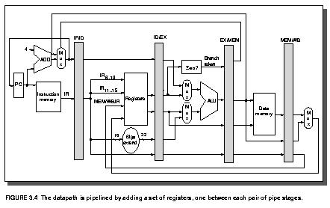
Solution: Use pipeline latches
IF → ID/RR → EX → Mem → WB
Latches between adjacent stages pipelining states (overhead)
Latch-contents should be propagated forward as the pipeline advances
Cons: Adds pipeline overhead; slows down the pipeline

Slide 59
Pipeline Speed-up
If all stages are balanced
i.e., all take the same time
Time between instructions_{pipelined} = Time between instructions_{nonpipelined} Number of stages
If not balanced, speed-up is less
Speed-up due to increased throughput
Latency (time for each instruction) does not decrease

Slide 60
Pipelining and ISA Design
MIPS ISA designed for pipelining
All instructions are 32-bits
Easier to fetch and decode in one cycle
c.f. x86: 1- to 17-byte instructions
Few and regular instruction formats
Can decode and read registers in one step (ID/RR)
Load/store addressing
Can calculate address in 3rd stage, access memory in 4th stage
Alignment of memory operands
Memory access takes only one cycle

Slide 61
Pipeline Hazards
Situations that prevent starting the next instruction in the next cycle; slows down the pipeline!
Structural hazards
A required resource is busy
Data hazard
Need to wait for previous instruction to complete its data read/write
Control hazard
Deciding on control action depends on previous instruction

Slide 62
Hazards - Elaborated
structural hazards: attempt to use the same resource by two different instructions at the same time
data hazards: attempt to use data before it is ready
An instruction’s source operand(s) are yet to be produced by a prior instruction, which is still in the pipeline
control hazards: attempt to make a decision about program control flow before the condition has been evaluated and the new PC target address calculated
branch instructions
Can always resolve hazards by waiting (inserting “bubbles” in the pipeline) – pipeline stall
pipeline control must detect the hazard
and take action to resolve hazards
Notes:
Note that data hazards can come from R-type instructions or lw instructions

Slide 63
Structural Hazard due to Memory Access Conflict
Time (clock cycles)
Reading data from memory
lw
IF
ID/R
EX
Mem
WB
I
n
s
t
r.
O
r
d
e
r
Inst 1
IF
ID/R
EX
Mem
WB
Inst 2
IF
ID/R
EX
Mem
WB
Inst 3
IF
ID/R
EX
Mem
WB
Inst 4
Reading instruction from memory
IF
ID/R
EX
Mem
WB
Solution: Use separate instruction and data memory modules

Slide 64
Structure Hazards
Conflict for use of a resource
In MIPS pipeline, with a single memory
Load/store requires data access
Instruction fetch would have to stall for that cycle
Would cause a pipeline “bubble” (stalls)
Hence, pipelined datapaths require separate instruction/data memories
Or, separate instruction/data caches

Slide 65
Data Hazards
These occur when at any time, there are active instructions that need to access the same data (memory or register) locations
Where there’s real trouble is when we have:
instruction A
instruction B
and B wants to manipulate (read or write) data before A does. This violates the order of the instructions, since the architecture implies that A completes entirely before B is executed.

Slide 66
Example: Hazards due to Register File Access
Time (clock cycles)
add $1,$3,$4
IF
ID/R
EX
Mem
WB
$1: destination register
I
n
s
t
r.
O
r
d
e
r
Inst 1
IF
ID/R
EX
Mem
WB
Inst 2
IF
ID/R
EX
Mem
WB
add $2,$1,
IF
ID/R
EX
Mem
WB
$1: source register
Notes:
For class handout

Slide 67
Solution: Register Write-Read Hazard?
Time (clock cycles)
Fix register access hazard by doing writes in the first half and reads in the second half of the clock cycle
add $1,
IF
ID/R
EX
Mem
WB
I
n
s
t
r.
O
r
d
e
r
Inst 1
IF
ID/R
EX
Mem
WB
Inst 2
IF
ID/R
EX
Mem
WB
add $2,$1,
IF
ID/R
EX
Mem
WB
clock edge that controls register writing
clock edge that controls loading of pipeline state registers
Notes:
For lecture
Define register reads to occur in the second half of the cycle and register writes in the first half

Slide 68
Register Usage Can Cause Data Hazards
Dependencies that are backward in time, cause hazards
add $1,$2,$3
IF
ID/R
EX
Mem
WB
$1: destination register
sub $4,$1,$5
IF
ID/R
EX
Mem
WB
$1: source register
and $6,$1,$7
IF
ID/R
EX
Mem
WB
or $8,$1,$9
IF
ID/R
EX
Mem
WB
$1: source register
xor $4,$1,$5
IF
ID/R
EX
Mem
WB
Read-before-write (RAW) data hazard
Notes:
For lecture

Slide 69
Loads Can Cause Data Hazards
Dependencies backward in time cause hazards
lw $1,4($2)
IF
ID/R
EX
Mem
WB
I
n
s
t
r.
O
r
d
e
r
sub $4,$1,$5
IF
ID/R
EX
Mem
WB
and $6,$1,$7
IF
ID/R
EX
Mem
WB
or $8,$1,$9
IF
ID/R
EX
Mem
WB
xor $4,$1,$5
IF
ID/R
EX
Mem
WB
Load-use data hazard
Notes:
Note that lw is just another example of register usage (beyond ALU ops)

Slide 70
One Way to “Fix” a Data Hazard: Use Bubbles
Can fix data hazard by waiting – stall – but impacts CPI
add $1,
IF
ID/R
EX
Mem
WB
I
n
s
t
r.
O
r
d
e
r
stall
stall
sub $4,$1,$5
IF
ID/R
EX
Mem
WB
and $6,$1,$7
IF
ID/R
EX
Mem
WB

Slide 71
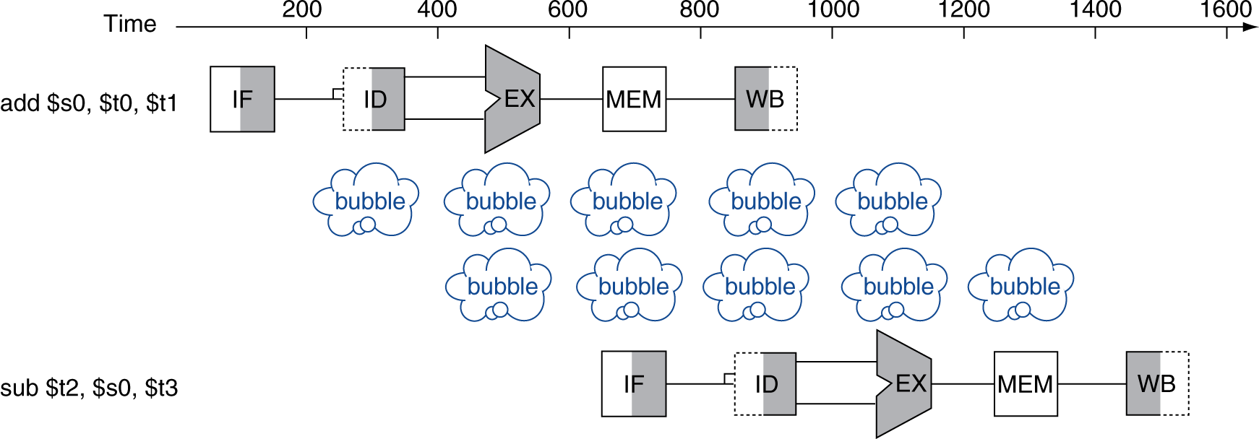
Data Hazards (contd..)
An instruction depends on completion of data access by a previous instruction
add $s0, $t0, $t1 sub $t2, $s0, $t3
“sub $t2, $s0, $t3” cannot enter pipeline here

Slide 72
Another Way to “Fix” a Data Hazard
Fix data hazards by forwarding results as soon as they are available to where they are needed
add $1,
IF
ID/R
EX
Mem
WB
I
n
s
t
r.
O
r
d
e
r
sub $4,$1,$5
IF
ID/R
EX
Mem
WB
and $6,$1,$7
IF
ID/R
EX
Mem
WB
or $8,$1,$9
IF
ID/R
EX
Mem
WB
xor $4,$1,$5
IF
ID/R
EX
Mem
WB
Notes:
For class handout

Slide 73
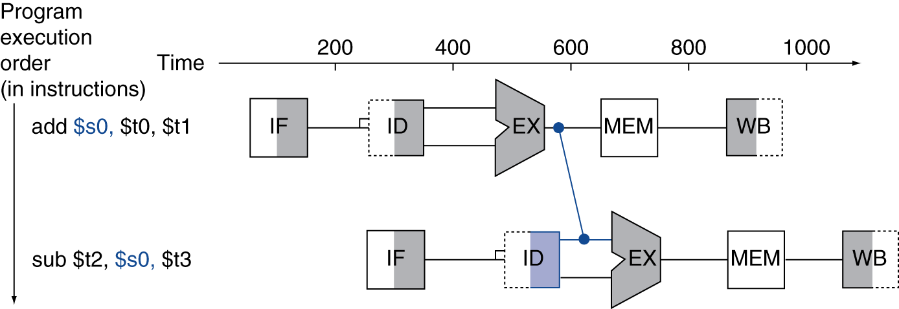
Forwarding (aka Bypassing)
Use result when it is computed
Don’t wait for it to be stored in a register
Requires extra connections in the datapath

Slide 74
Data Forwarding (in time) to “Fix” a Data Hazard
Fix data hazards by forwarding results as soon as they are available to where they are needed
add $1,
IF
ID/R
EX
Mem
WB
I
n
s
t
r.
O
r
d
e
r
sub $4,$1,$5
IF
ID/R
EX
Mem
WB
and $6,$1,$7
IF
ID/R
EX
Mem
WB
or $8,$1,$9
IF
ID/R
EX
Mem
WB
xor $4,$1,$5
IF
ID/R
EX
Mem
WB
Notes:
For lecture
Forwarding paths are valid only if the destination stage is later in time than the source stage.
Forwarding is harder if there are multiple results to forward per instruction or if they need to write a result early in the pipeline

Slide 75
Forwarding (aka Bypassing)
Use result when it is computed
Don’t wait for it to be stored in a register
Requires extra connections in the datapath from the output of ALU (EX) to the input of the same ALU!

Slide 76
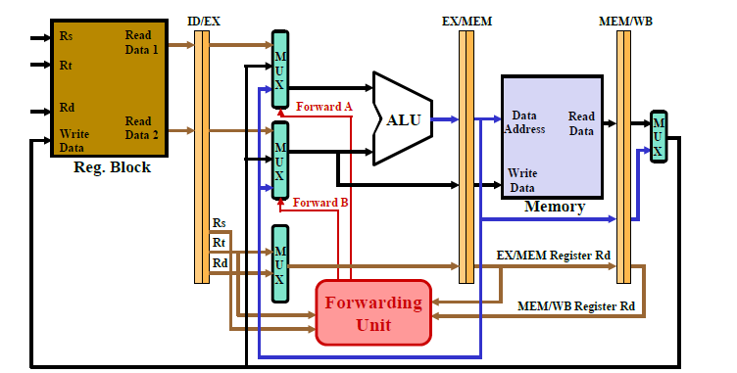
Data Forwarding Needs Extra Hardware (Ex→Ex)

Slide 77
Forwarding with Load-Use Data Hazards
lw $1,4($2)
IF
ID/R
EX
Mem
WB
I
n
s
t
r.
O
r
d
e
r
sub $4,$1,$5
IF
ID/R
EX
Mem
WB
and $6,$1,$7
IF
ID/R
EX
Mem
WB
or $8,$1,$9
IF
ID/R
EX
Mem
WB
xor $4,$1,$5
IF
ID/R
EX
Mem
WB
Notes:
For class handout

Slide 78
Forwarding with Load-Use Data Hazards
Mem-to-Ex data forwarding
lw $1,4($2)
IF
ID/R
EX
Mem
WB
I
n
s
t
r.
O
r
d
e
r
sub $4,$1,$5
IF
ID/R
EX
Mem
WB
Solution: Push one time-step forward (i.e., insert STALL);
Stall is inevitable!
and $6,$1,$7
IF
ID/R
EX
Mem
WB
or $8,$1,$9
IF
ID/R
EX
Mem
WB
xor $4,$1,$5
IF
ID/R
EX
Mem
WB
Will still need one stall cycle even with forwarding
We cannot forward data “backward in time”!
Notes:
For lecture
Note that lw is just another example of register usage (beyond ALU ops)
Need to stall even with forwarding when data hazard involves a load

Slide 79
Data Hazards
The stall is necessary as shown here.
Time (clock cycles)
I
n
s
t
r.
O
r
d
e
r
lw r1, 0(r2)
Ifetch
Reg
ALU
DMem
Reg
Bubble
sub r4,r1,r6
Ifetch
Reg
ALU
DMem
Reg
Bubble
and r6,r1,r7
Ifetch
Reg
ALU
DMem
Reg
Bubble
or r8,r1,r9
Ifetch
Reg
ALU
DMem
There are some instances where hazards occur, even with forwarding.

Slide 80
Tabular Representation of Pipeline
LW R1, 0(R2) | IF | ID | EX | MEM | WB
SUB R4, R1, R5 |  | IF | ID | EX | MEM | WB
AND R6, R1, R7 |  |  | IF | ID | EX | MEM | WB
OR R8, R1, R9 |  |  |  | IF | ID | EX | MEM | WB
data hazard
LW R1, 0(R2) | IF | ID | EX | MEM | WB
SUB R4, R1, R5 |  | IF | ID | stall | EX | MEM | WB
AND R6, R1, R7 |  |  | IF | stall | ID | EX | MEM | WB
OR R8, R1, R9 |  |  |  | stall | IF | ID | EX | MEM | WB

Slide 81
RAW Data Hazards
Read-After-Write (RAW)
Instr_{J} tries to read operand before Instr_{I} writes it
Caused by “dependence”.
I: add $1,$2,$3
J: sub $4,$1,$3

Slide 82
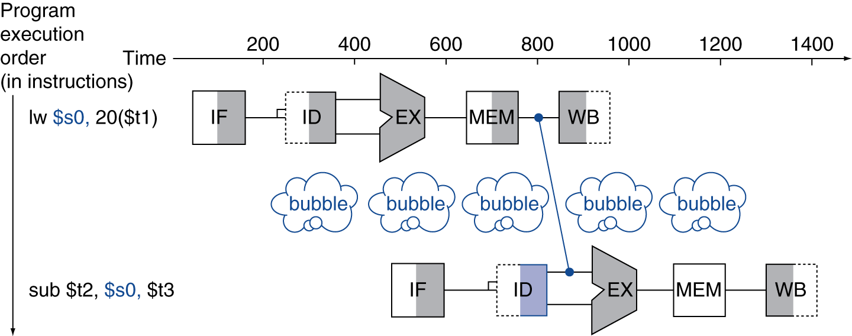
Summary: Load-Use Data Hazard
Can’t always avoid stalls by forwarding
If value not computed when needed
Can’t forward backward in time!
Need stalls so that forwarding is possible

Slide 83
Cons: Data Forwarding Needs Extra Hardware (Mem→Ex) in addition to Ex → EX

Slide 84
Code Scheduling to Avoid Stalls
Reorder code to avoid use of load result in the next instruction
C code for A = B + E; C = B + F;
lw $t1, 0($t0)
lw $t2, 4($t0)
add $t3, $t1, $t2
sw $t3, 12($t0)
lw $t4, 8($t0)
add $t5, $t1, $t4
sw $t5, 16($t0)
lw $t1, 0($t0)
lw $t2, 4($t0)
lw $t4, 8($t0)
add $t3, $t1, $t2
sw $t3, 12($t0)
add $t5, $t1, $t4
sw $t5, 16($t0)
stall
stall
13 cycles
11 cycles

Slide 85
Recap: Pipelined Processor Design

Slide 86
Pipelining Lessons
What Is Pipelining
6 PM
7
8
9
Pipelining doesn’t help latency of single task, it helps throughput of entire workload
Pipeline rate limited by slowest pipeline stage
Multiple tasks operating simultaneously
Potential speed-up < Number pipe stages (pipe-depth)
Unbalanced lengths of pipe stages reduces speed-up
Time to “fill” pipeline and time to “drain” it reduces speedup
Stall for Dependences
Time
T
a
s
k
O
r
d
e
r
30
40
40
40
40
20
A
B
C
D

Slide 87
MIPS Pipeline
Five stages, one step per stage
IF: Instruction fetch from memory
ID/RR: Instruction decode & register read
EX: Execute operation or calculate address
MEM: Access memory operand
WB: Write result back to register

Slide 88
Datapath With Control
Instruction
Fetch
Instr. Decode
Reg. Fetch
Execute
Addr. Calc
Memory
Access
Write
Back
IF → ID/RR → EX → Mem → WB
Latches between adjacent stages pipelining states (overhead)
Latch-contents should be propagated forward as the pipeline advances

Slide 89
Pipeline Hazards
Situations that prevent starting the next instruction in the next cycle; slows down the pipeline! Effective CPI increases.
Structural hazards
A required resource is busy
Data hazard
Need to wait for previous instruction to complete its data read/write
Control hazard
Deciding on control action depends on previous instruction
To avoid data hazard:
Use bubbles (stalls)
Use half-cycle Register Write (first)/Register Read (second)
Use data forwarding by hardware (ALU_out → ALU_in; Mem_out → ALU_in
Use code-reordering by compiler
To avoid structural hazard:
Use bubbles (stalls)
Use separate instruction/data memories
or, separate instruction/data caches

Slide 90
Control Hazards
A control hazard is when we need to find the destination of a branch, and cannot fetch any new instructions until we know that destination

Slide 91
Control Hazards (beq)
Branch determines flow of control
Fetching next instruction depends on branch outcome
Pipeline can’t always fetch correct instruction
Still working on ID stage of branch
In MIPS pipeline, we can reduce branch penalty
by comparing registers (zero-checking) and computing target (PC-update) early in the pipeline
Add hardware to do it in ID-stage

Slide 92
Example: Control Hazards due to Branch
Dependencies backward in time cause hazards
beq
IF
ID/R
EX
Mem
WB
I
n
s
t
r.
O
r
d
e
r
lw
IF
ID/R
EX
Mem
WB
Inst 3
IF
ID/R
EX
Mem
WB
Inst 4
IF
ID/R
EX
Mem
WB

Slide 93
Datapath With Control
Execute
Addr. Calc
Instruction
Fetch
Instr. Decode
Reg. Fetch
Execute
Addr. Calc
Memory
Access
Write
Back
Use a separate ALU for comparing two registers (zero-checker), and move target address-computation and PC-update MUX, HERE: ID/RR
IF → ID/RR → EX → Mem → WB
Outcome of branch is known at the end of EX; PC-update is being done in Mem-stage

Slide 94
One Way to “Fix” a Control Hazard
Fix branch hazard by waiting – stall – but affects CPI
I
n
s
t
r.
O
r
d
e
r
beq
IF
ID/R
EX
Mem
WB
stall
stall
stall
lw
IF
ID/R
EX
Mem
WB
Inst 3
Notes:
Another “solution” is to put in enough extra hardware so that we can test registers, calculate the branch address, and update the PC during the second stage of the pipeline. That would reduce the number of stalls to only one.
A third approach is to prediction to handle branches, e.g., always predict that branches will be untaken. When right, the pipeline proceeds at full speed. When wrong, have to stall (and make sure nothing completes – changes machine state – that shouldn’t have). Will talk about these options in more detail in next,next lecture.

Slide 95
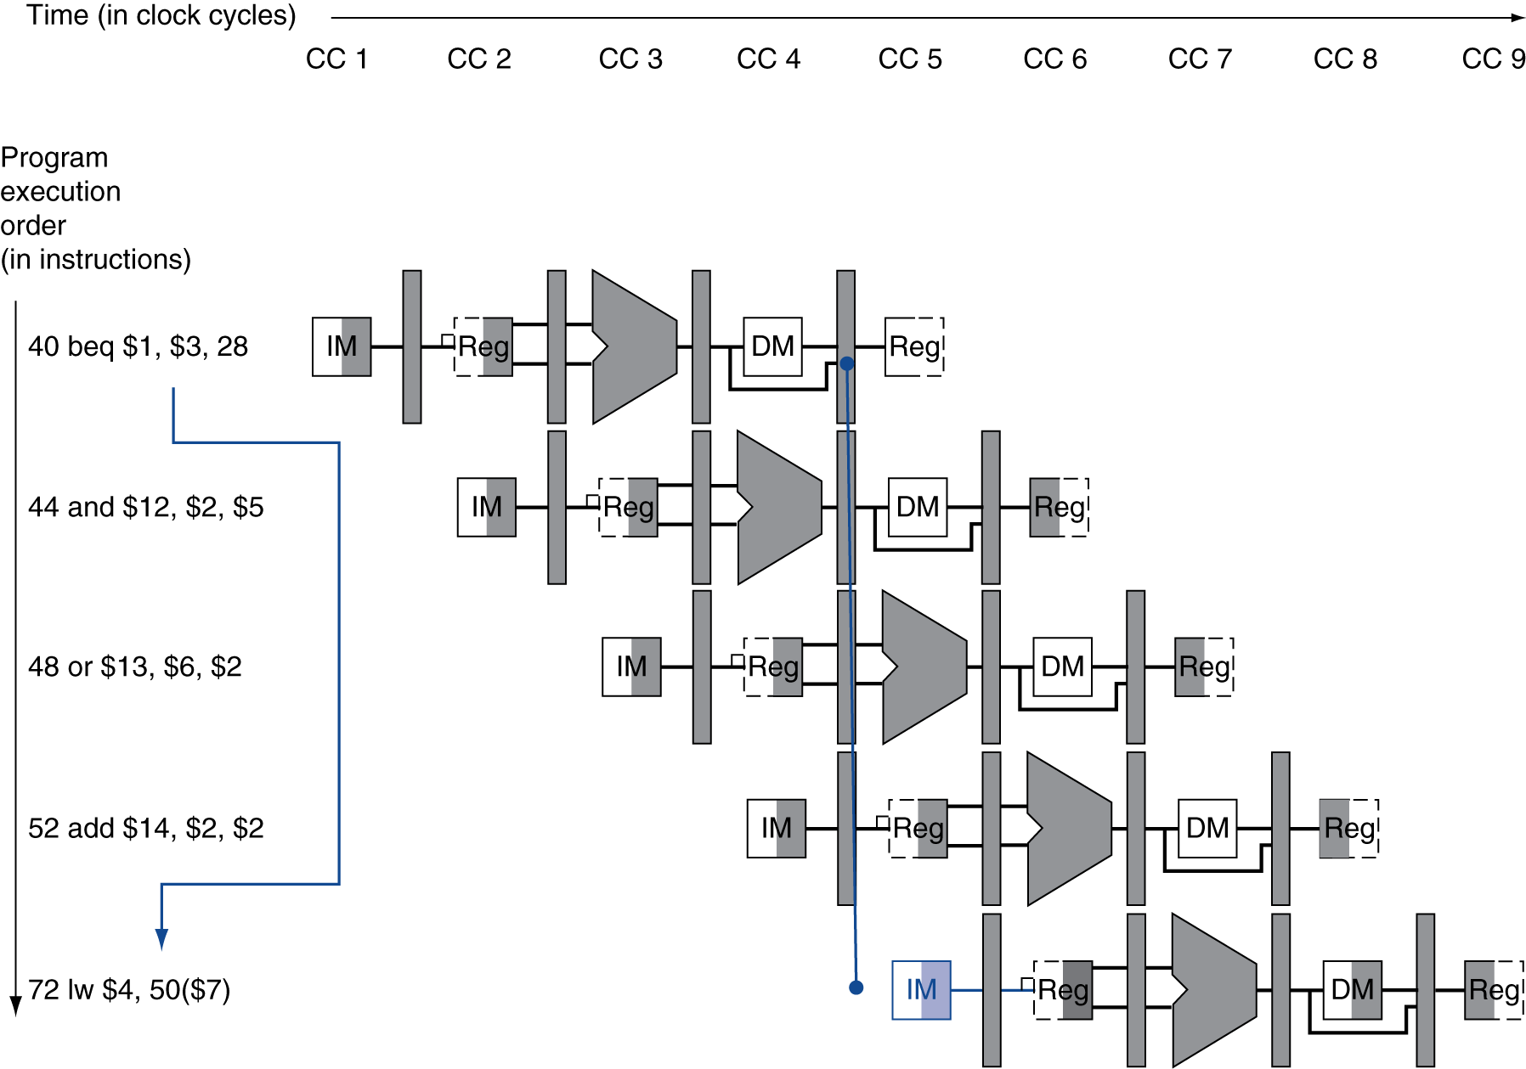
Branch Hazards
§4.8 Control Hazards
If branch outcome determined in MEM
Flush these instructions
3 stall cycles
PC

Slide 96
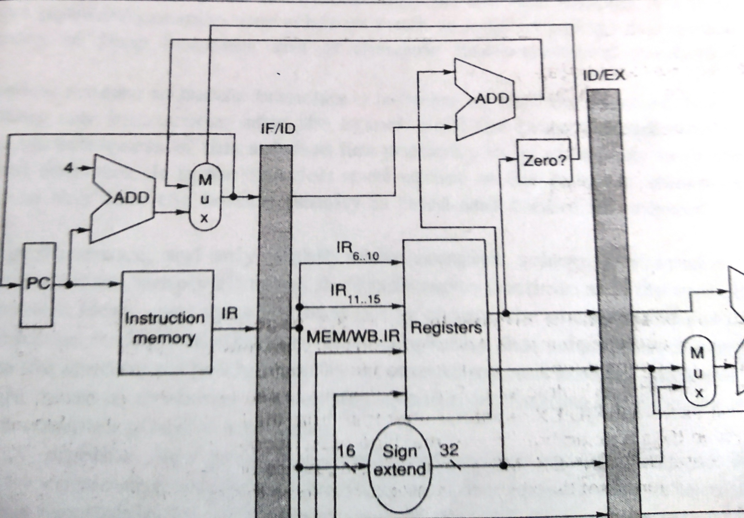
Control Hazards (beq) – So far
In MIPS pipeline, we can reduce branch penalty
by comparing registers (zero-checking) and computing target (PC-update) early in the pipeline
Add hardware to do it in ID-stage
In other words,
Find out earlier whether the branch is taken or not-taken (add zero-checker to ID-stage)
Compute target-address of taken-branch earlier (allocate hardware resources at the ID-stage)

Slide 97
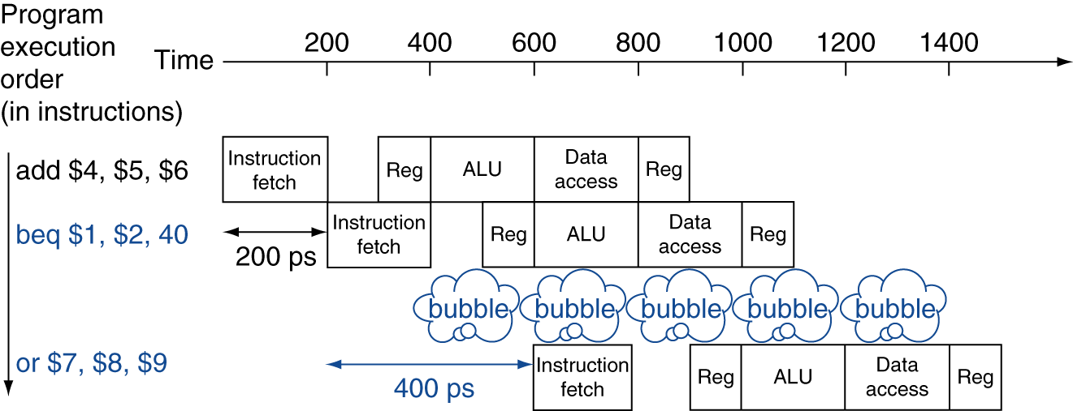
Stall on Branch
Wait until branch outcome determined before fetching next instruction

Slide 98
Another Approach: Branch Prediction
Longer pipelines can’t readily determine branch outcome early
Fixed stall-penalty becomes unacceptable
Predict outcome of branch
Stall only if prediction is wrong
In MIPS pipeline, use
Predict-not-taken (normal flow: PC + 4)
Fetch instruction after branch, with no delay

Slide 99
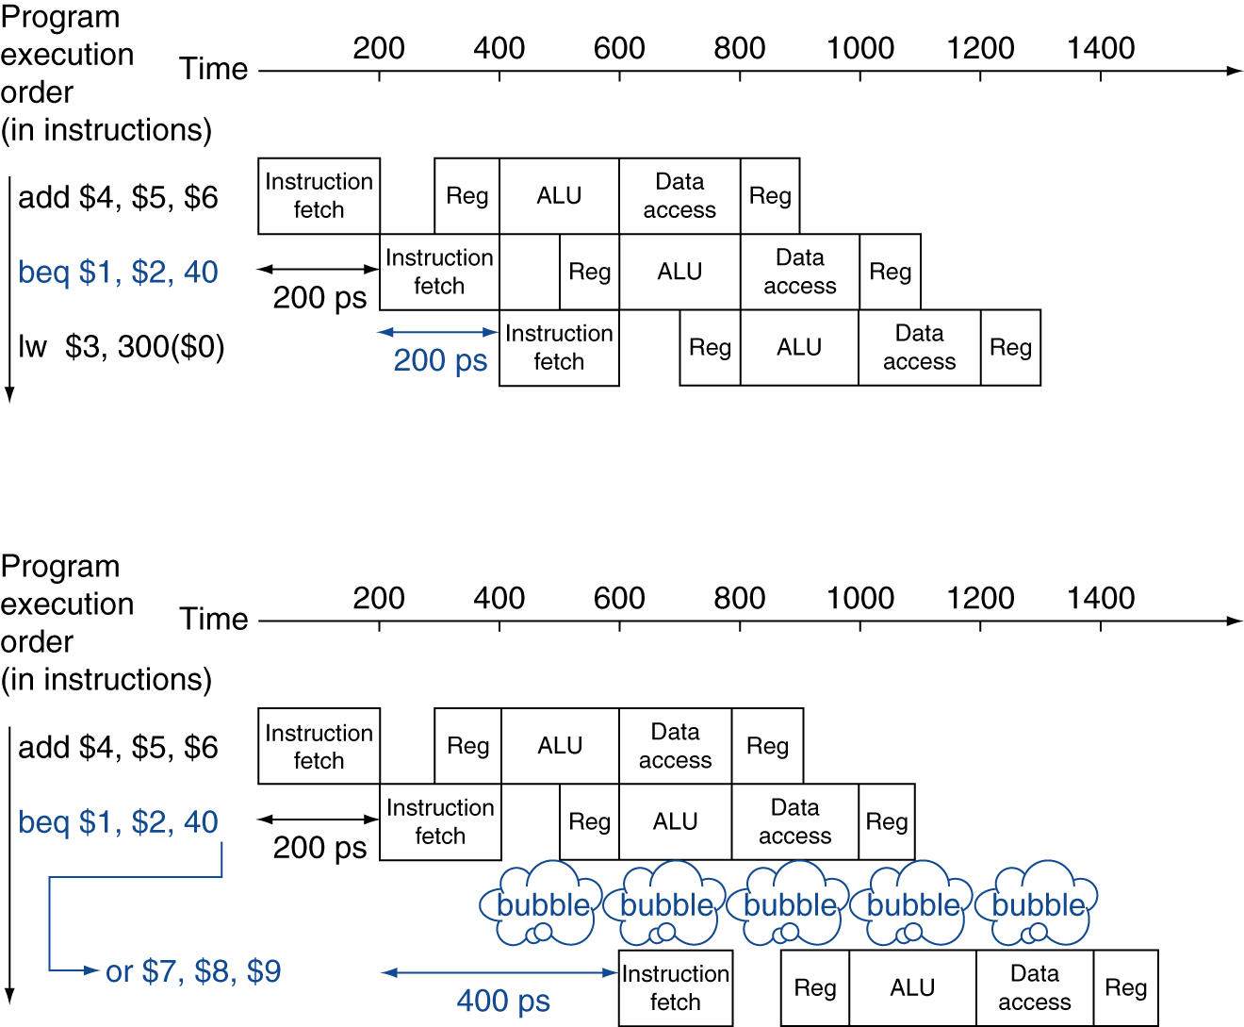
MIPS with Predict-Not-Taken
No stall
Prediction correct (branch-not-taken)
1 clock cycle in pipelined machine
= 200 ps
one-cycle stall, with modified hardware
Prediction incorrect (branch taken)

Slide 100
Branch Hazard Solutions
Control Hazards
#1: Stall until branch target is known (3 stalls per branch)
#2: Move zero-checking and target-address computation earlier (in ID/RR-Stage)
#3: Predict Branch-Not-Taken
Execute successor instructions in sequence
(no stall is branch is not taken)
“Squash” instructions in pipeline if branch actually taken (one stall)
47% MIPS branches not taken on average
PC+4 already calculated, so use it to get next instruction

Slide 101
More-Realistic Branch Prediction
Static branch prediction
Based on typical branch behavior
Example: loop and if-statement branches
Predict backward branches taken
Predict forward branches not-taken
Dynamic branch prediction
Hardware measures actual branch behavior
e.g., record recent history of each branch
Assume future behavior will continue the trend
When wrong, stall while re-fetching, and update history

Slide 102
Dynamic Branch Prediction
In deeper and superscalar pipelines, branch penalty is more significant
Use dynamic prediction
Branch prediction buffer (aka branch history table)
Indexed by recent branch instruction addresses
Stores outcome (taken/not taken)
To execute a branch
Check table, expect the same outcome
Start fetching from fall-through or target
If wrong, flush pipeline and flip prediction

Slide 103
1-Bit Predictor: Shortcoming
Inner loop branches mispredicted twice!
outer: … … inner: …
…
beq …, …, inner … beq …, …, outer
Mispredict as taken on last iteration of inner loop
Then mispredict as not taken on first iteration of inner loop next time around

Slide 104
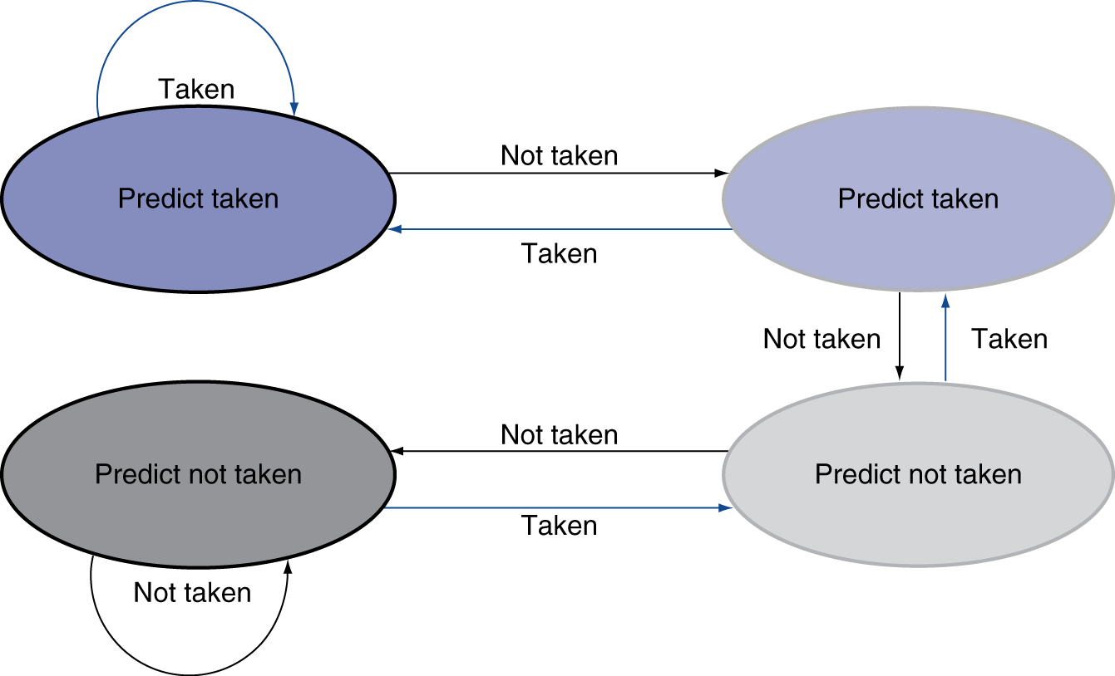
2-Bit Predictor
Only change prediction on two successive mispredictions

Slide 105
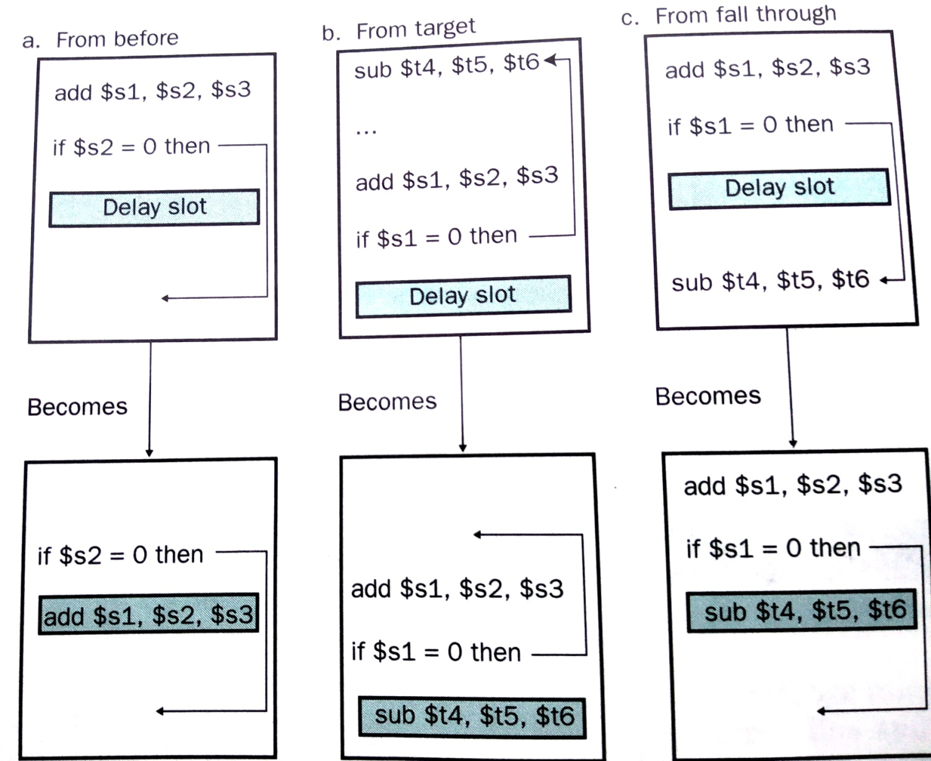
Another solution to improve branch hazard performance: Delay-Slot (Compiler assisted)

Slide 106
Calculating the Branch Target
Even with predictor, still need to calculate the target address
1-cycle penalty for a taken branch
Branch target buffer
Cache of target addresses
Indexed by PC when instruction fetched
If hit and instruction is branch predicted taken, can fetch target immediately

Slide 107
Pipeline Datapaths, Hazard Detectors, and Forwarding Hardware

Slide 108
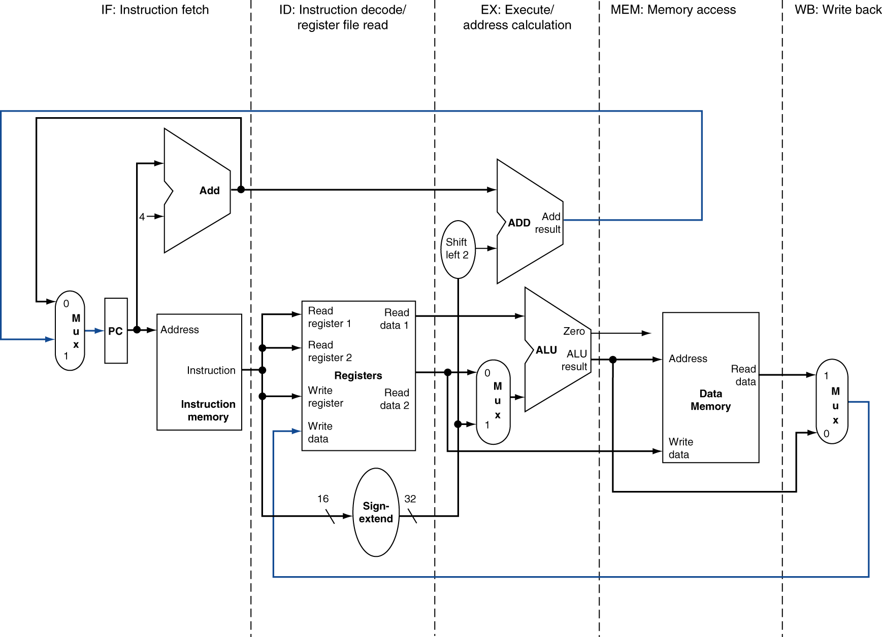
MIPS Pipelined Datapath
§4.6 Pipelined Datapath and Control
MEM
Right-to-left flow leads to hazards
WB

Slide 109
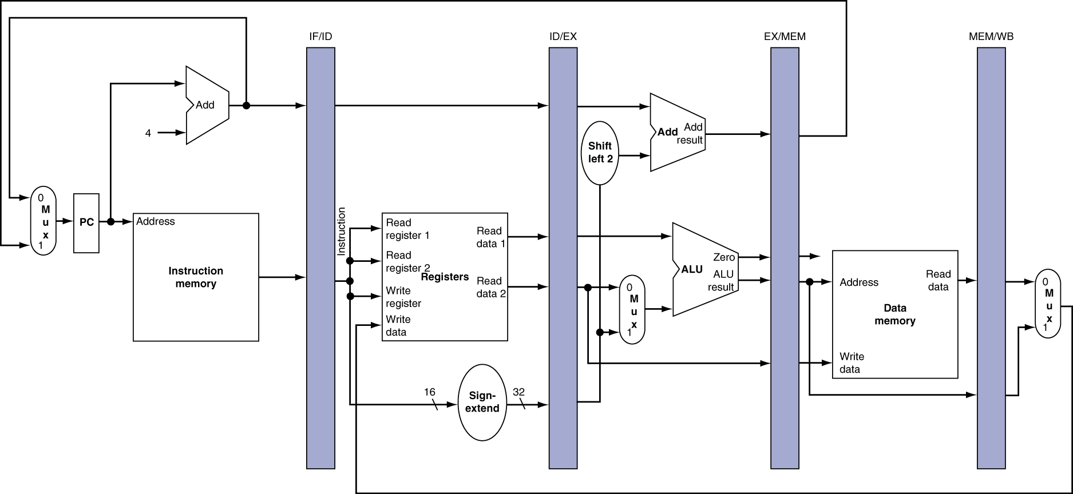
Pipeline registers
Need registers between stages
To hold information produced in previous cycle

Slide 110
Pipeline Operation
Cycle-by-cycle flow of instructions through the pipelined datapath
“Single-clock-cycle” pipeline diagram
Shows pipeline usage in a single cycle
Highlight resources used
c.f. “multi-clock-cycle” diagram
Graph of operation over time
We’ll look at “single-clock-cycle” diagrams for load & store

Slide 111
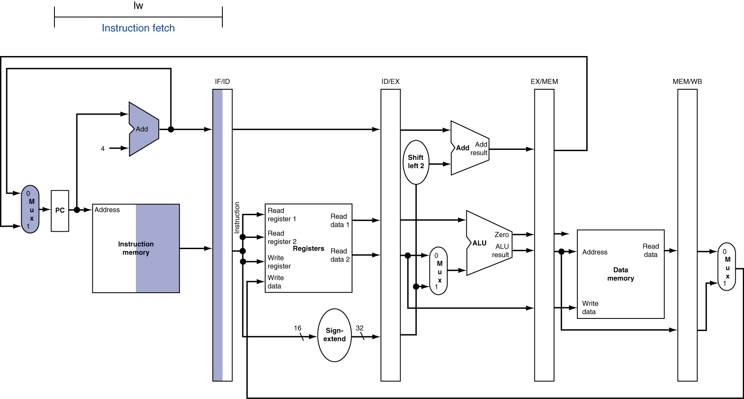
IF for Load, Store, …

Slide 112
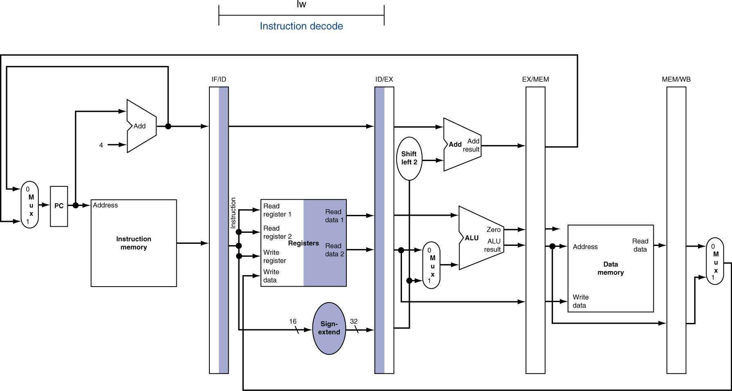
ID for Load, Store, …

Slide 113
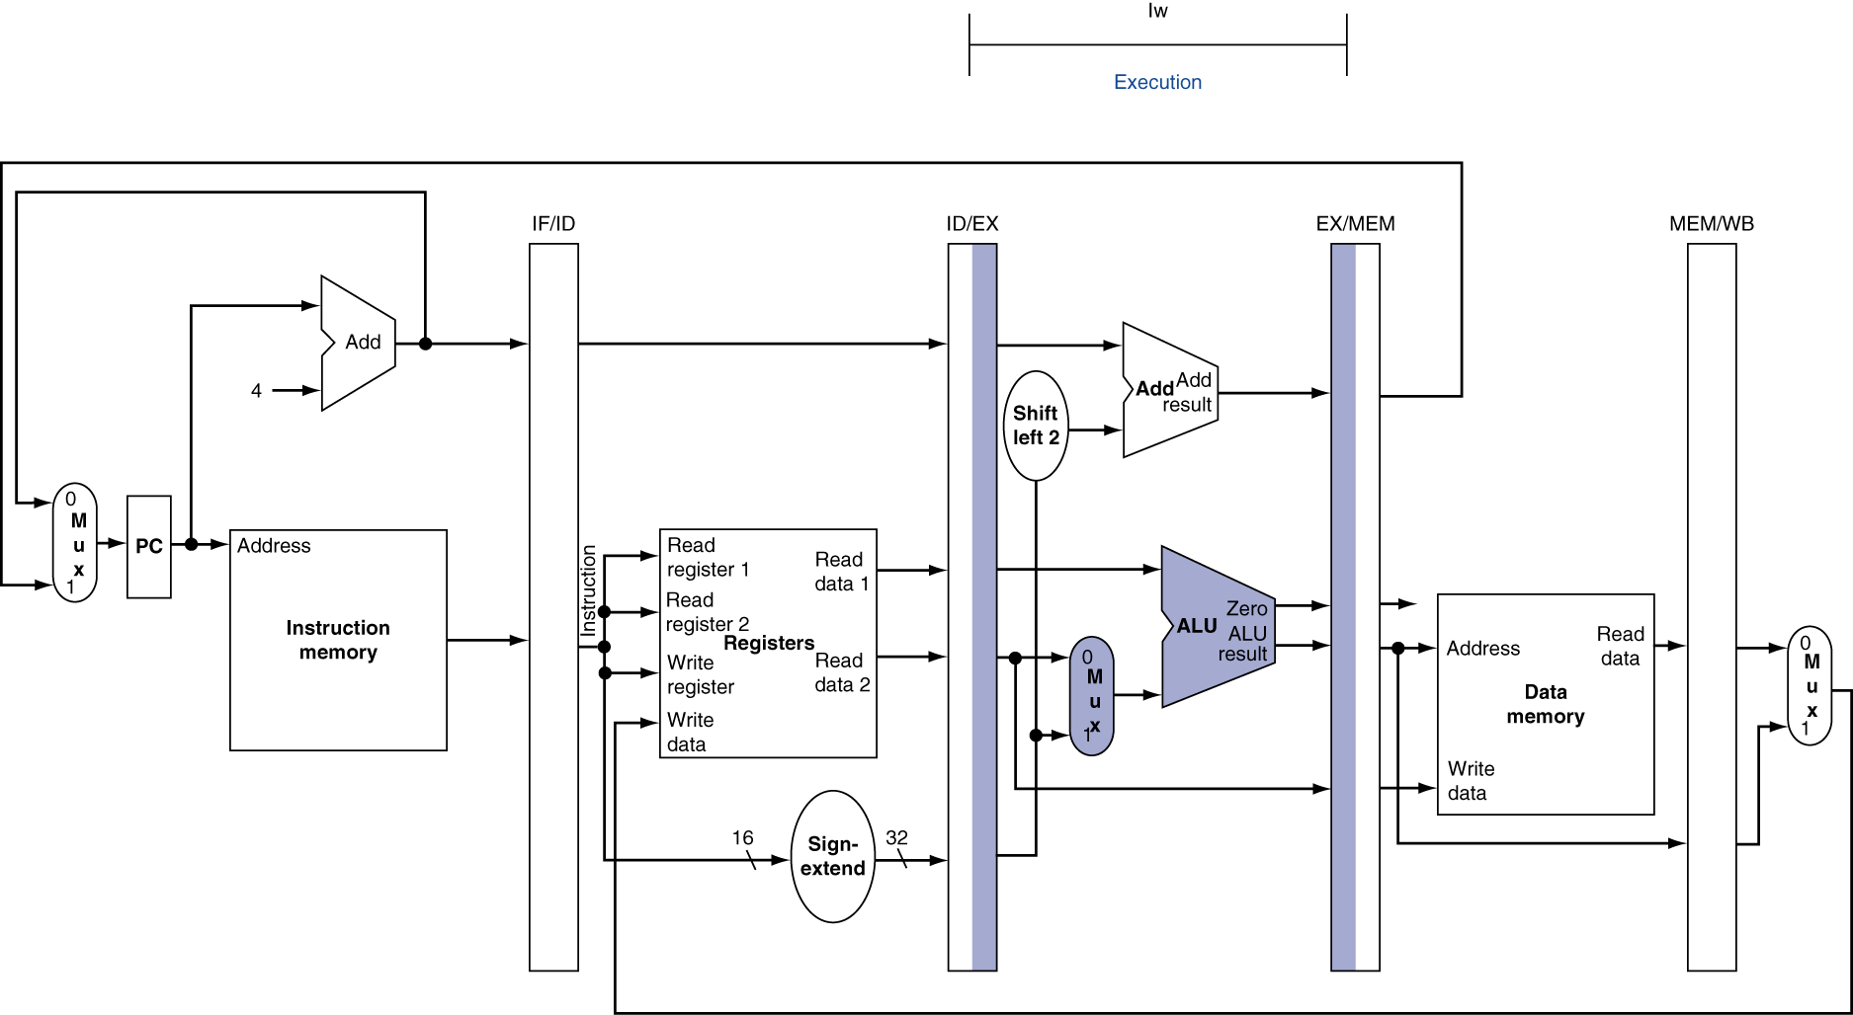
EX for Load

Slide 114
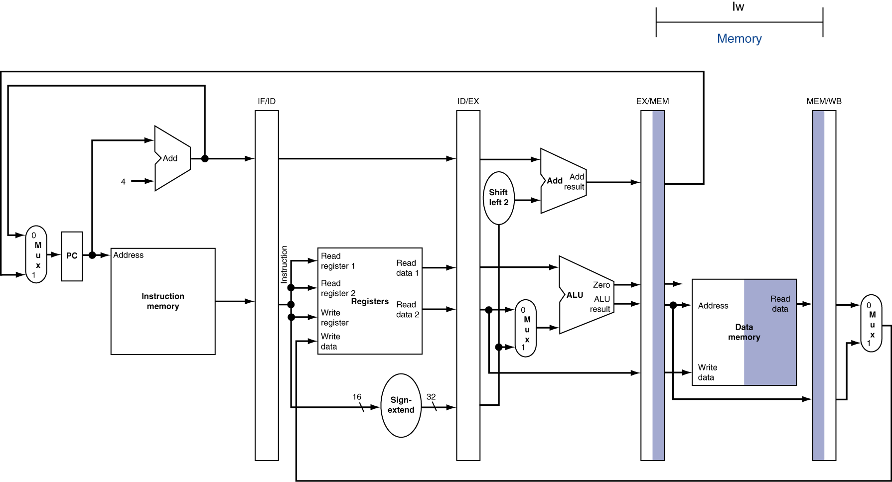
MEM for Load

Slide 115
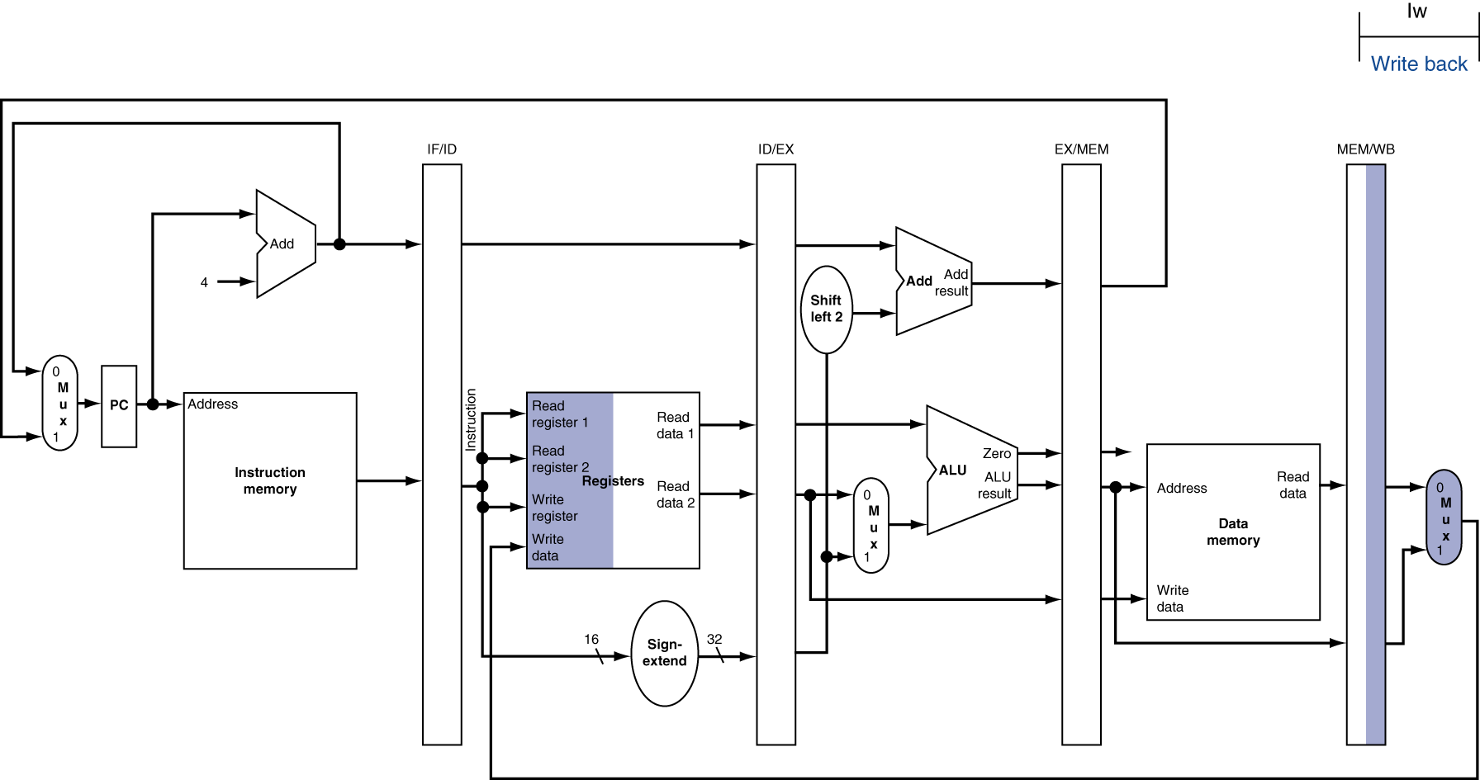
WB for Load
Wrong register number

Slide 116
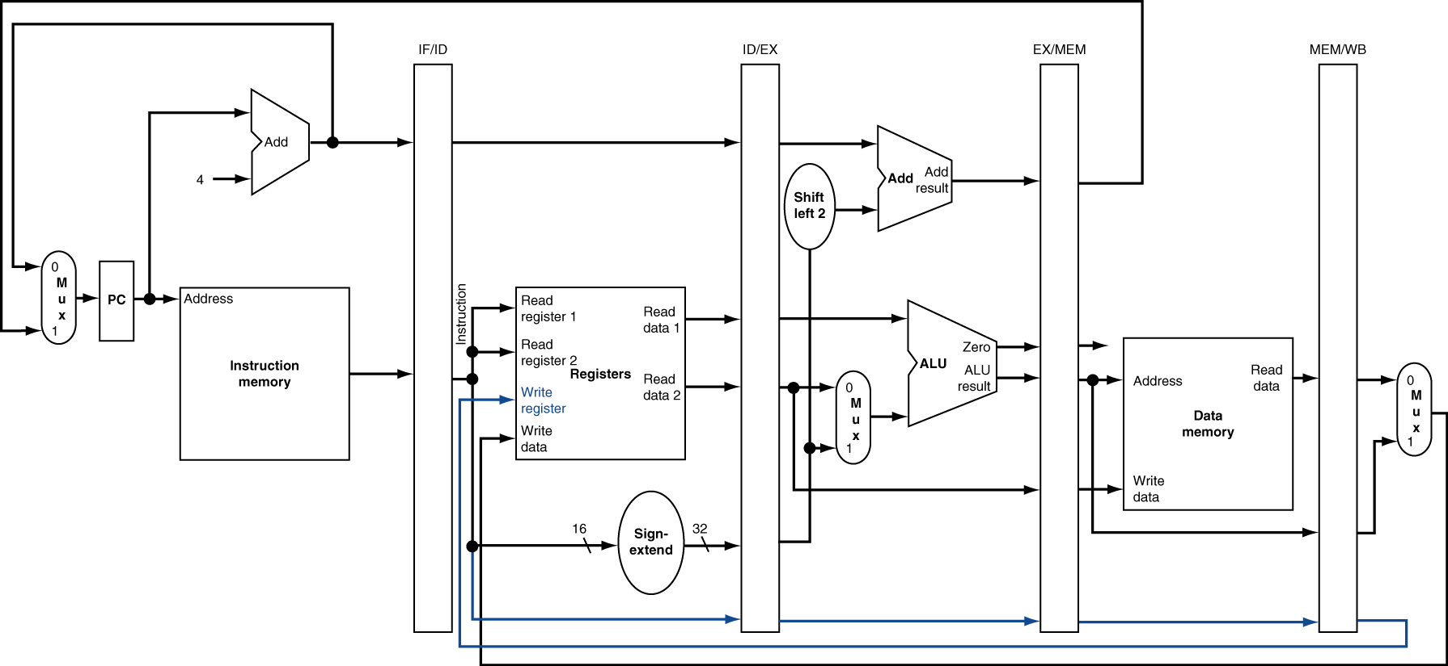
Corrected Datapath for Load

Slide 117

EX for Store

Slide 118
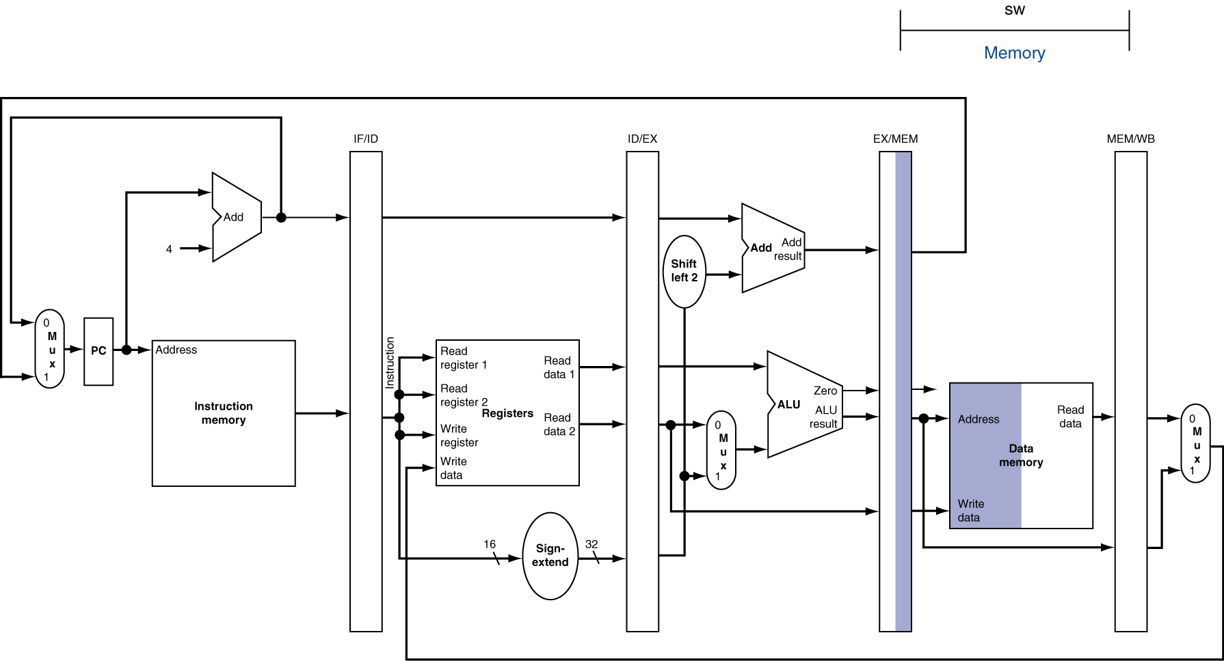
MEM for Store

Slide 119
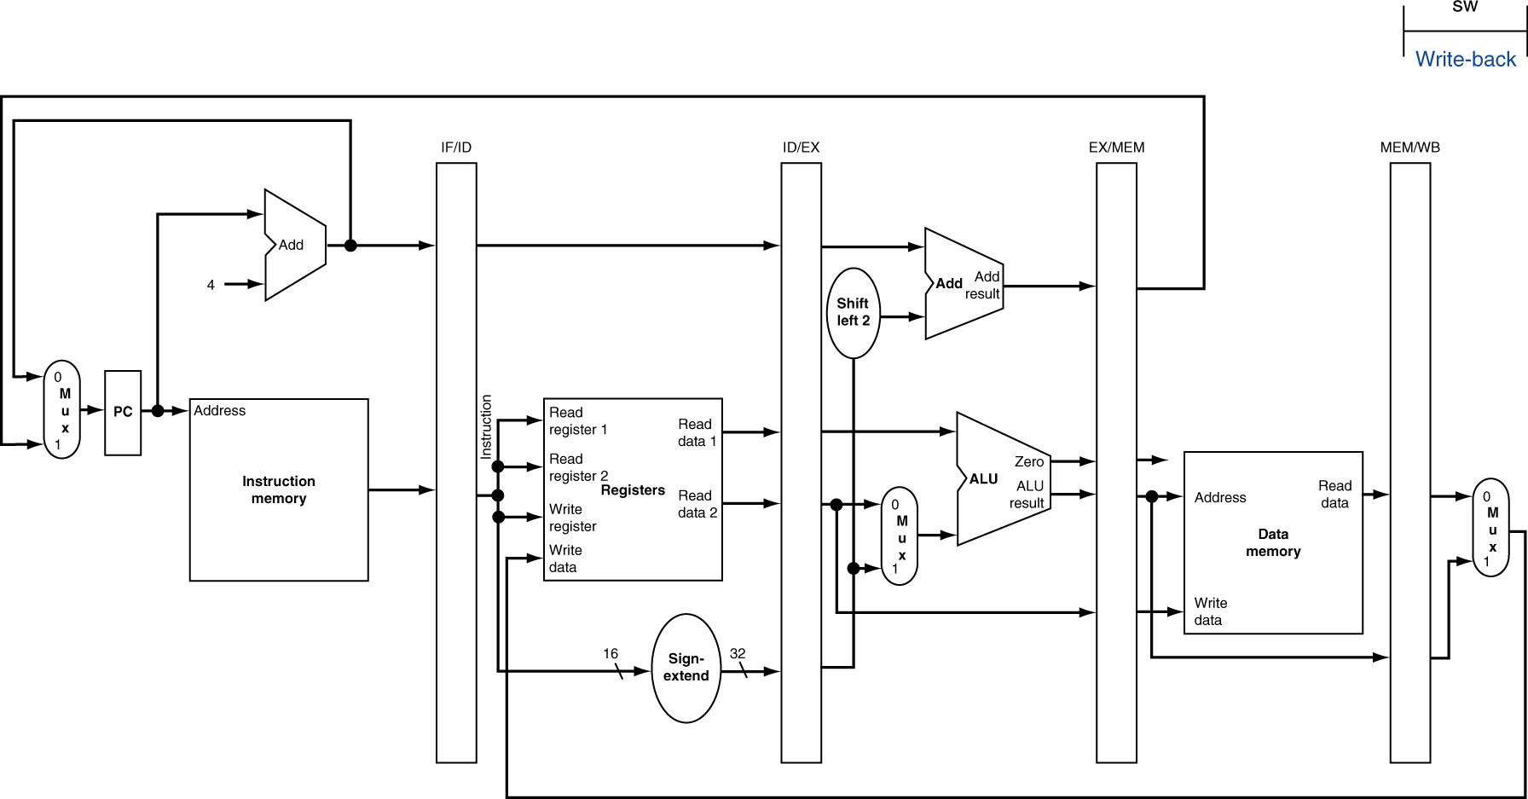
WB for Store

Slide 120
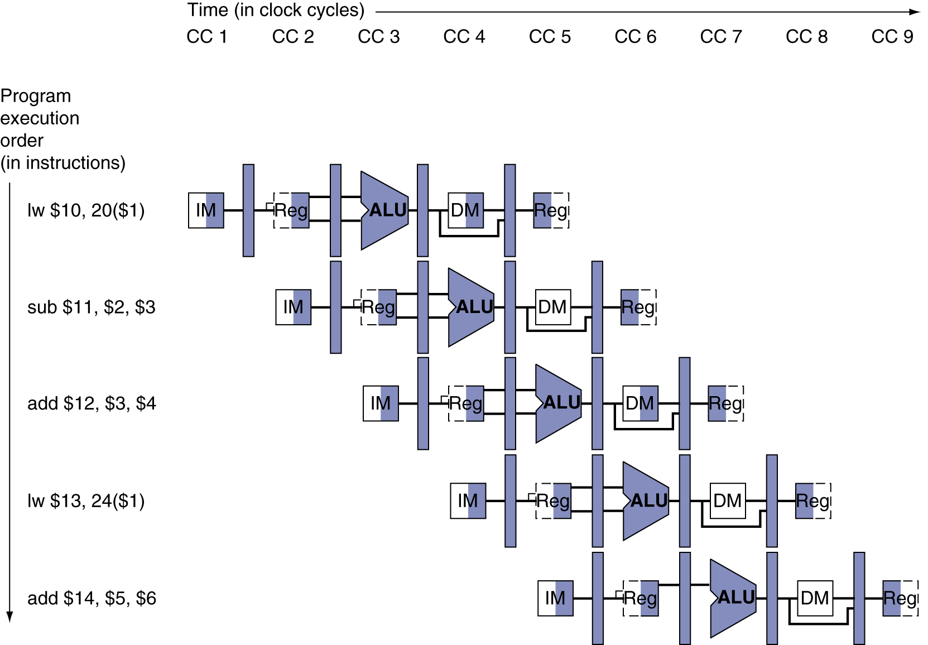
Multi-Cycle Pipeline Diagram
Form showing resource usage
Watch Read/Write half-cycles in register files, Inst. Mem (IM) and in Data Mem (DM)

Slide 121
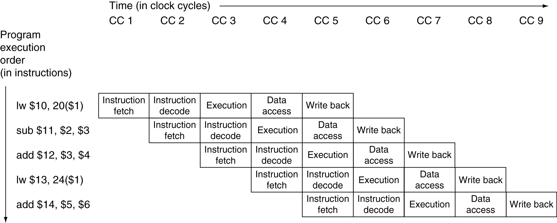
Multi-Cycle Pipeline Diagram
Traditional (Tabular) form

Slide 122
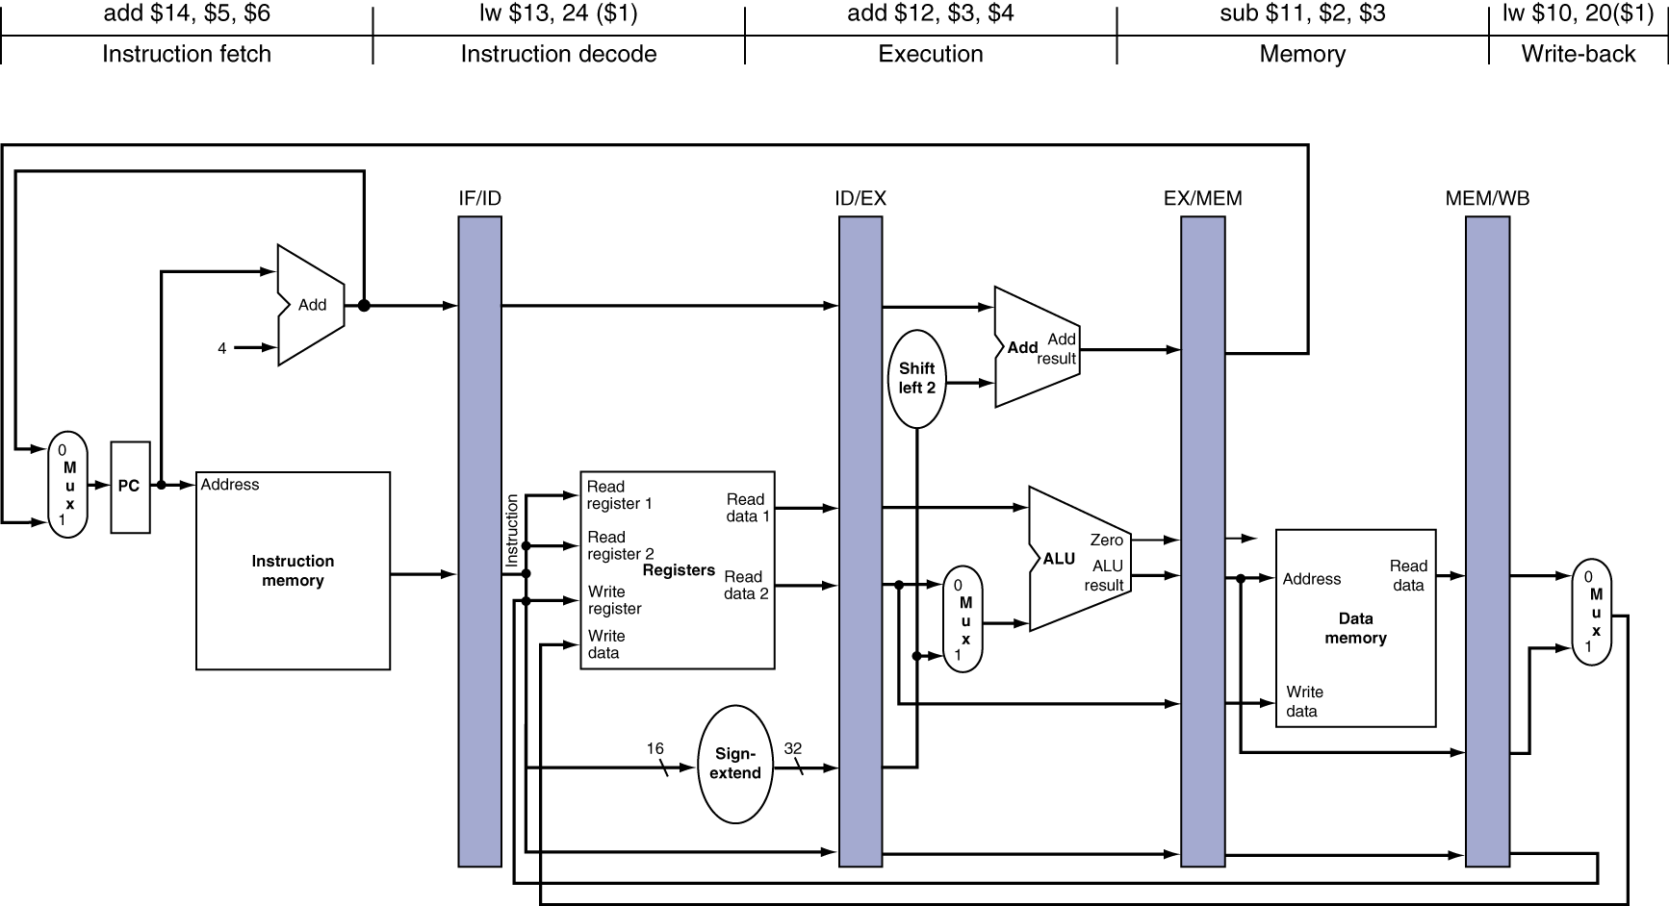
Single-Cycle Pipeline Diagram
State of the pipeline in the 5th cycle
lw $10, 20($1)
sub $11, $2, $3
add $12, $3, $4
lw $13, 24($1)
add $14, $5, $6

Slide 123
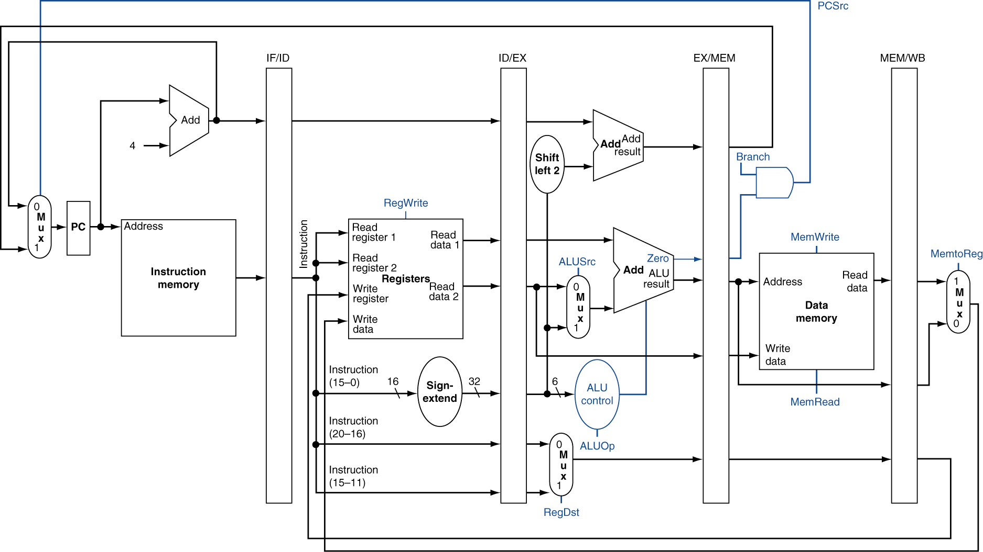
Pipelined Control (Simplified)

Slide 124
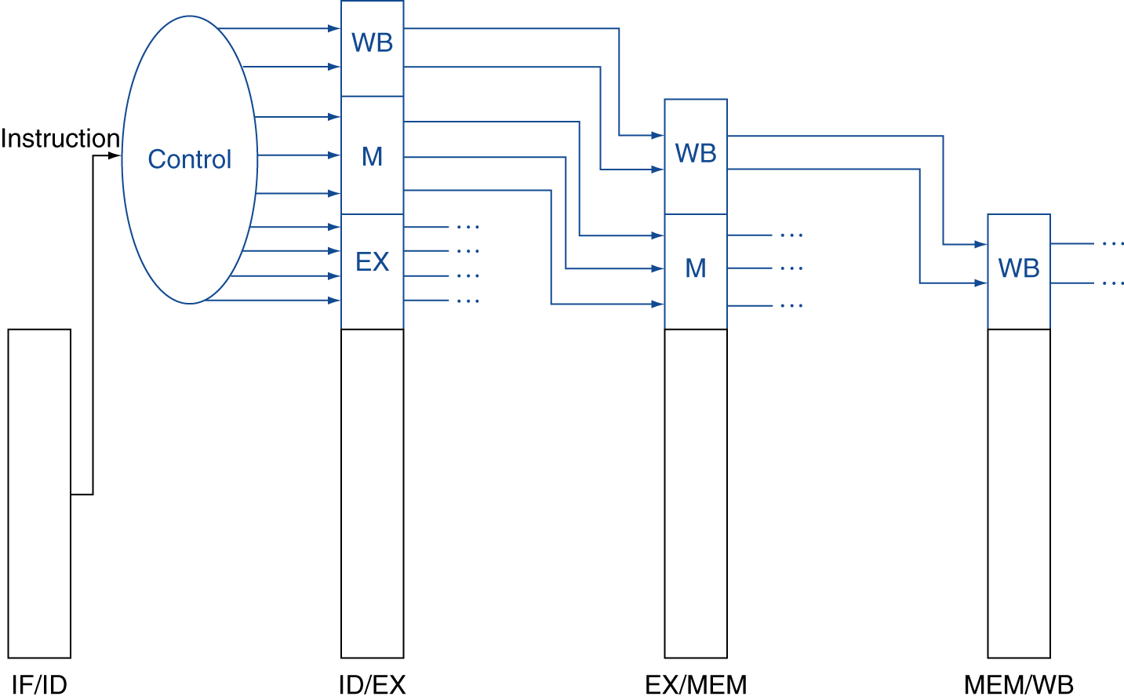
Pipelined Control
Control signals derived from instruction
As in single-cycle implementation
Inter-stage latches
IF → ID/RR → EX → Mem → WB

Slide 125
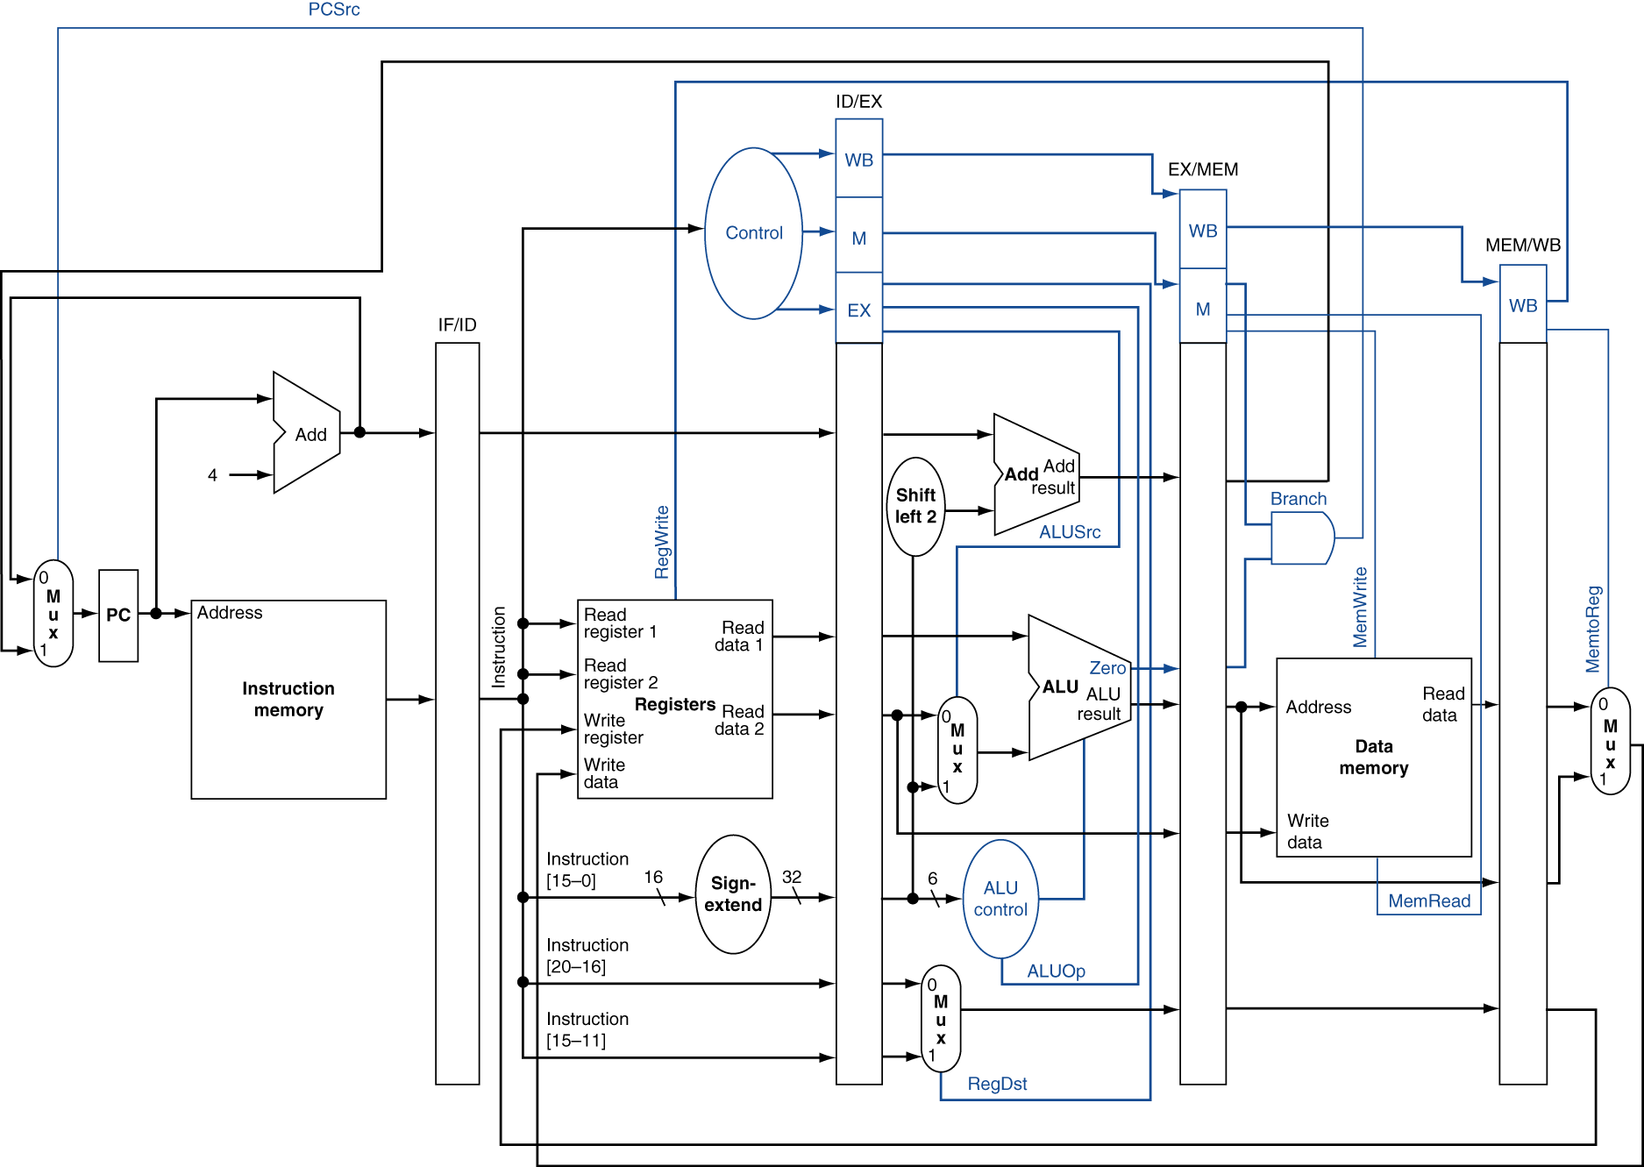
Pipelined Control
What is the branch penalty for this architecture?
-- 3 clock cycles

Slide 126
Data Hazards in ALU Instructions
Consider this sequence:
sub $2, $1,$3 and $12,$2,$5 or $13,$6,$2 add $14,$2,$2 sw $15,100($2)
We can resolve hazards with forwarding
How do we detect when to forward?
IF ID/RR EX Mem WB
§4.7 Data Hazards: Forwarding vs. Stalling
IF ID/RR EX Mem WB

Slide 127
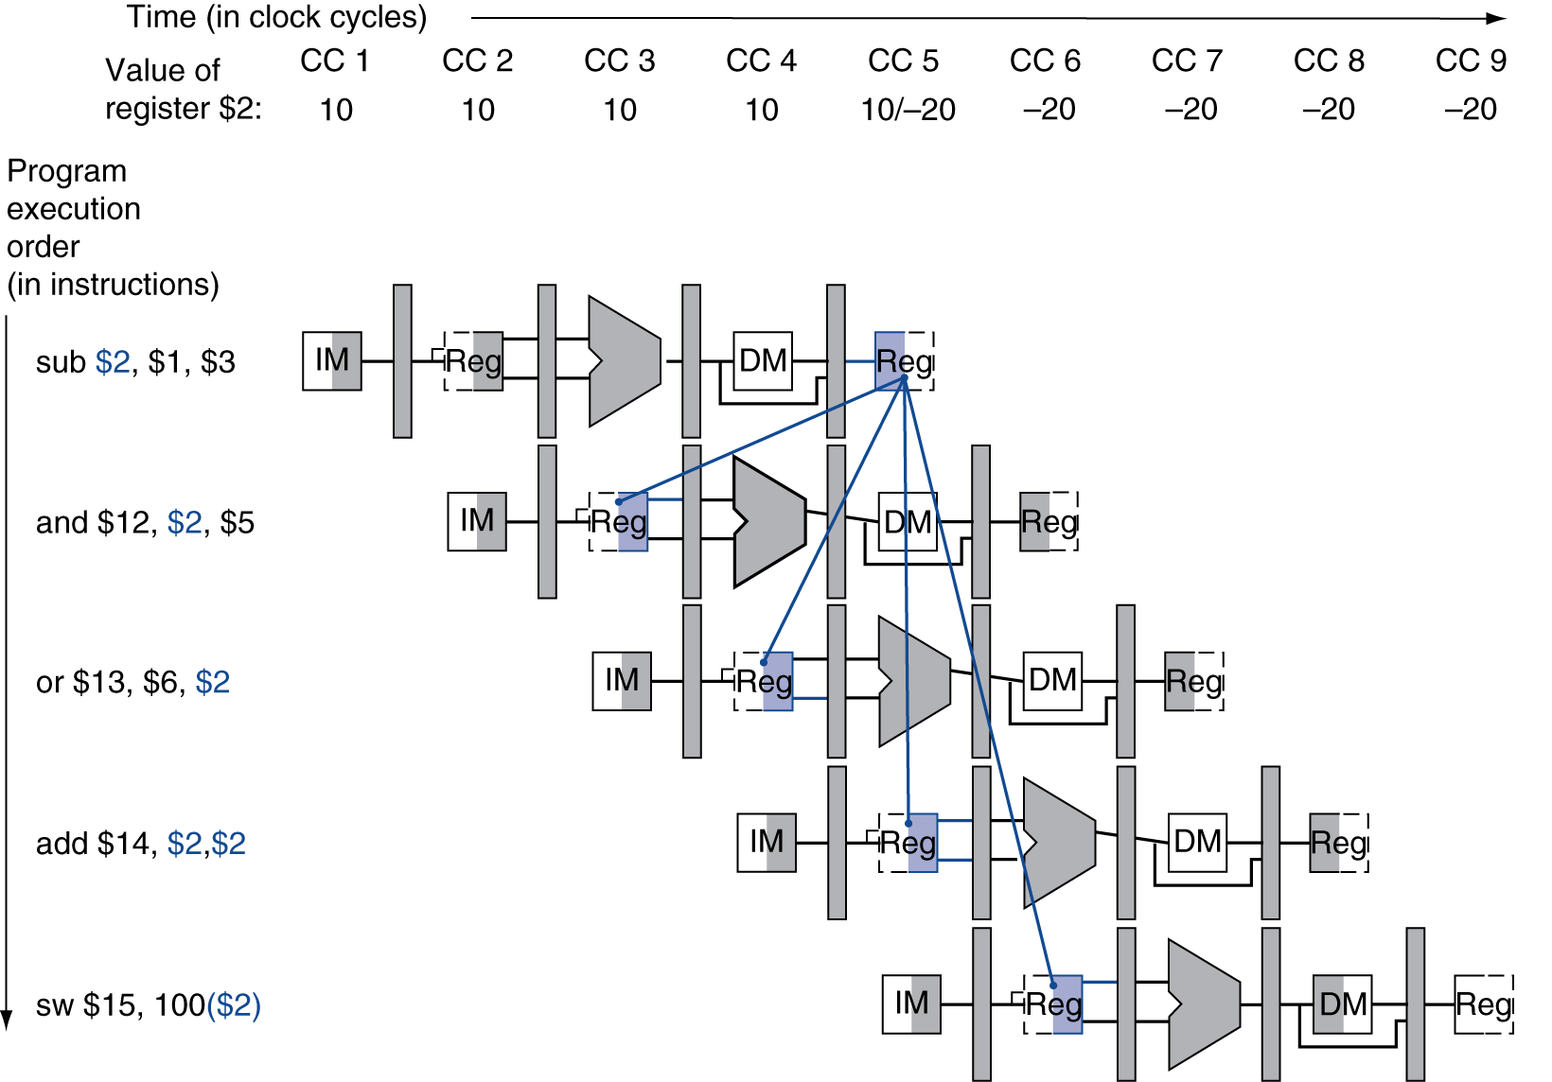
Dependencies & Forwarding

Slide 128
Detecting the Need to Forward
Pass register numbers along pipeline
e.g., ID/EX.RegisterRs = register number for Rs sitting in ID/EX pipeline register
ALU operand register numbers in EX stage are given by
ID/EX.RegisterRs, ID/EX.RegisterRt
Data hazards when
1a. EX/MEM.RegisterRd = ID/EX.RegisterRs
1b. EX/MEM.RegisterRd = ID/EX.RegisterRt
2a. MEM/WB.RegisterRd = ID/EX.RegisterRs
2b. MEM/WB.RegisterRd = ID/EX.RegisterRt
Fwd from EX/MEM pipeline reg
Fwd from MEM/WB pipeline reg

Slide 129
Detecting the Need to Forward
But only if forwarding instruction will write to a register!
EX/MEM.RegWrite, MEM/WB.RegWrite
And only if Rd for that instruction is not $zero
EX/MEM.RegisterRd ≠ 0, MEM/WB.RegisterRd ≠ 0

Slide 130
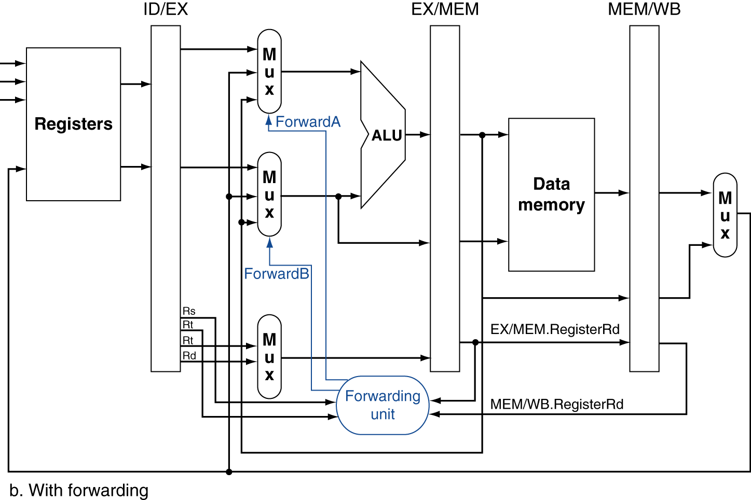
Forwarding Paths

Slide 131
Forwarding Conditions
EX hazard
if (EX/MEM.RegWrite and (EX/MEM.RegisterRd ≠ 0) and (EX/MEM.RegisterRd = ID/EX.RegisterRs)) ForwardA = 10
if (EX/MEM.RegWrite and (EX/MEM.RegisterRd ≠ 0) and (EX/MEM.RegisterRd = ID/EX.RegisterRt)) ForwardB = 10
MEM hazard
if (MEM/WB.RegWrite and (MEM/WB.RegisterRd ≠ 0) and (MEM/WB.RegisterRd = ID/EX.RegisterRs)) ForwardA = 01
if (MEM/WB.RegWrite and (MEM/WB.RegisterRd ≠ 0) and (MEM/WB.RegisterRd = ID/EX.RegisterRt)) ForwardB = 01

Slide 132
Double Data Hazard
Consider the sequence:
add $1,$1,$2 add $1,$1,$3 add $1,$1,$4
Both hazards occur
Want to use the most recent
Revise MEM hazard condition
Only fwd if EX hazard condition isn’t true

Slide 133
Revised Forwarding Condition
MEM hazard
if (MEM/WB.RegWrite and (MEM/WB.RegisterRd ≠ 0) and not (EX/MEM.RegWrite and (EX/MEM.RegisterRd ≠ 0) and (EX/MEM.RegisterRd = ID/EX.RegisterRs)) and (MEM/WB.RegisterRd = ID/EX.RegisterRs)) ForwardA = 01
if (MEM/WB.RegWrite and (MEM/WB.RegisterRd ≠ 0) and not (EX/MEM.RegWrite and (EX/MEM.RegisterRd ≠ 0) and (EX/MEM.RegisterRd = ID/EX.RegisterRt)) and (MEM/WB.RegisterRd = ID/EX.RegisterRt)) ForwardB = 01

Slide 134
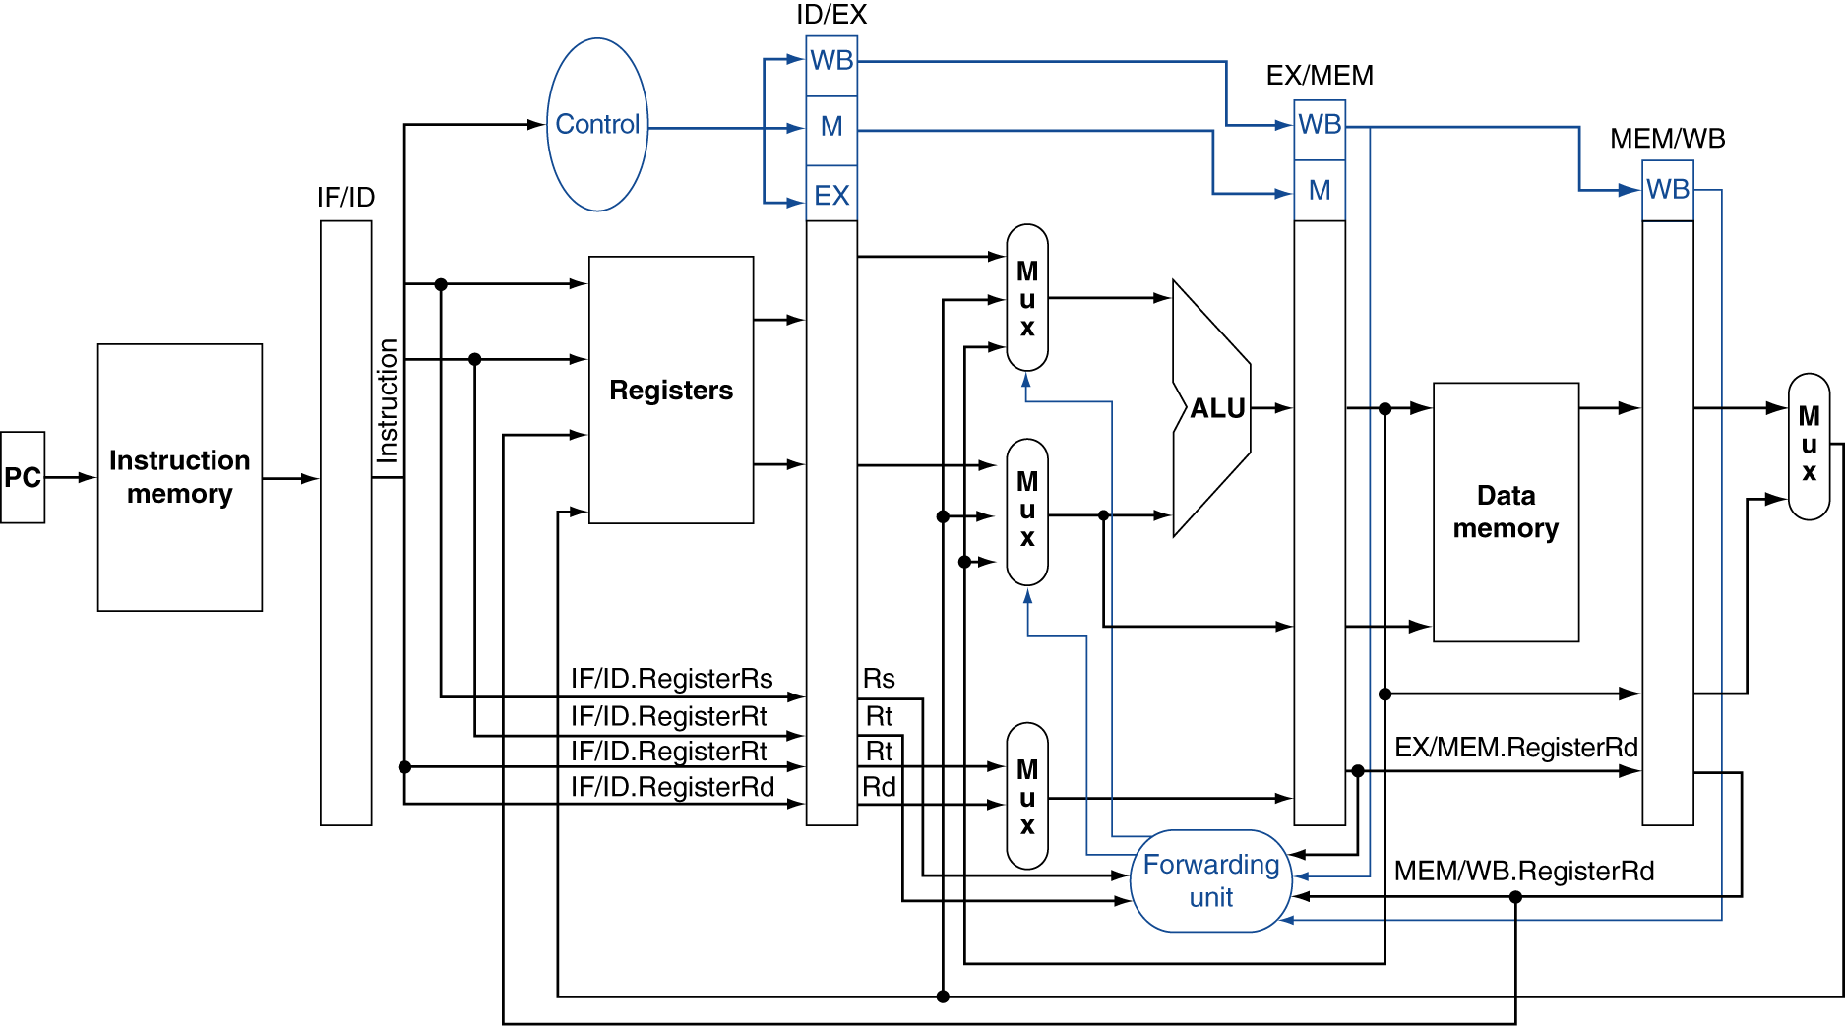
Datapath with Forwarding

Slide 135
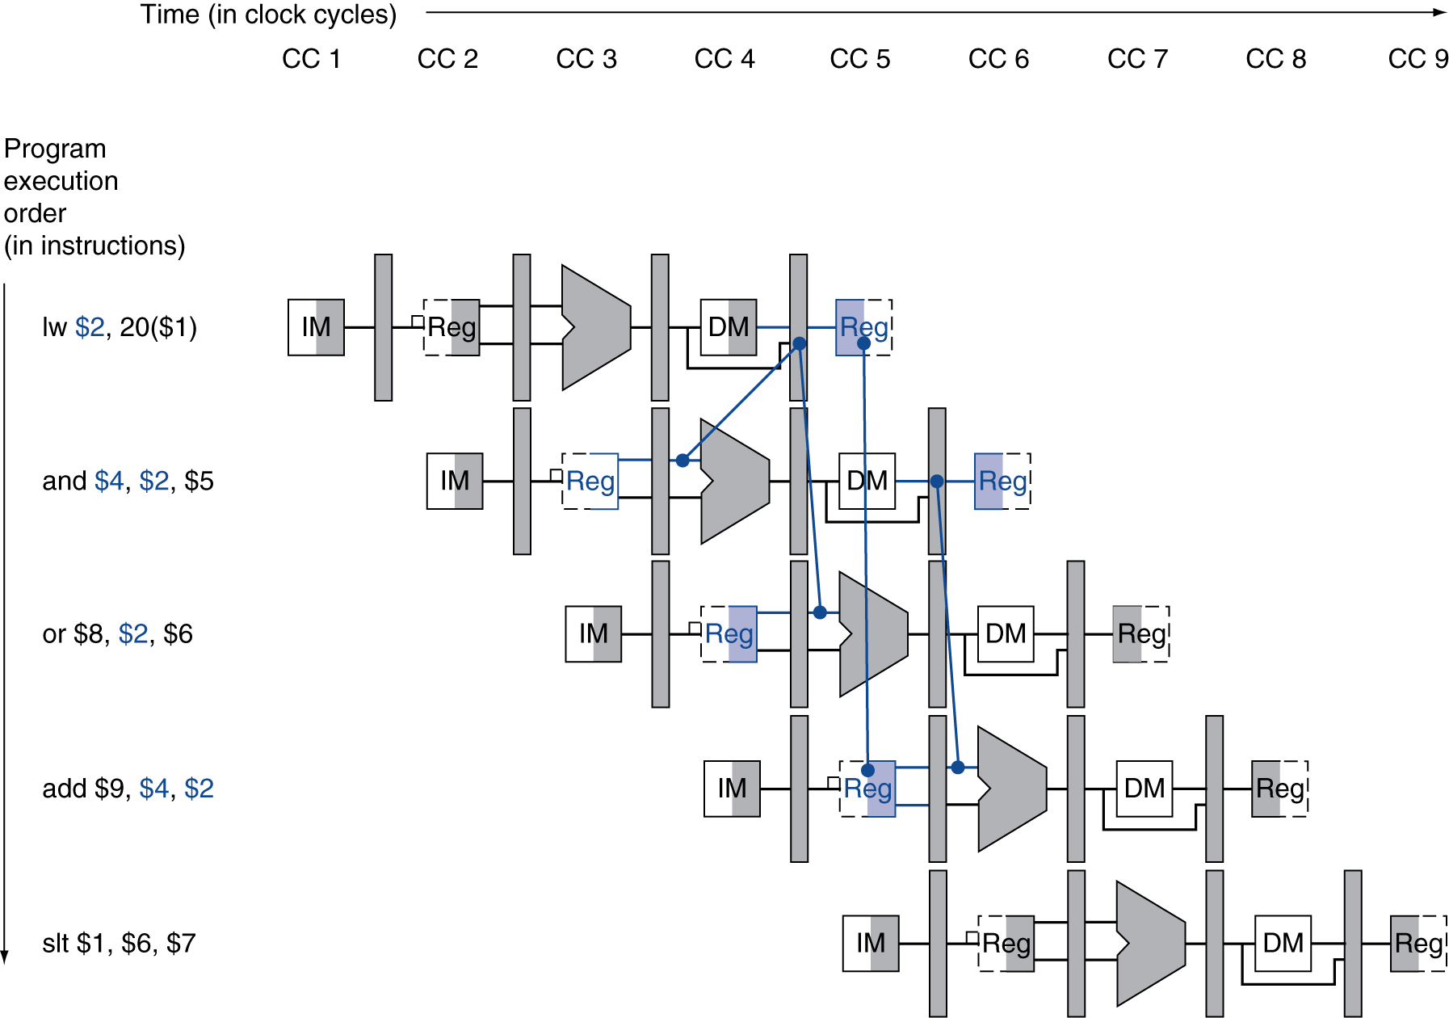
Load-Use Data Hazard
Need to stall for one cycle

Slide 136
Load-Use Hazard Detection
Check when using instruction is decoded in ID stage
ALU operand register numbers in ID stage are given by
IF/ID.RegisterRs, IF/ID.RegisterRt
Load-use hazard when
ID/EX.MemRead and ((ID/EX.RegisterRt = IF/ID.RegisterRs) or (ID/EX.RegisterRt = IF/ID.RegisterRt))
If detected, stall and insert bubble

Slide 137
How to Stall the Pipeline
Force control values in ID/EX register to 0
EX, MEM and WB do nop (no-operation)
Prevent update of PC and IF/ID register
Using instruction is decoded again
Following instruction is fetched again
1-cycle stall allows MEM to read data for lw
Can subsequently forward to EX stage

Slide 138
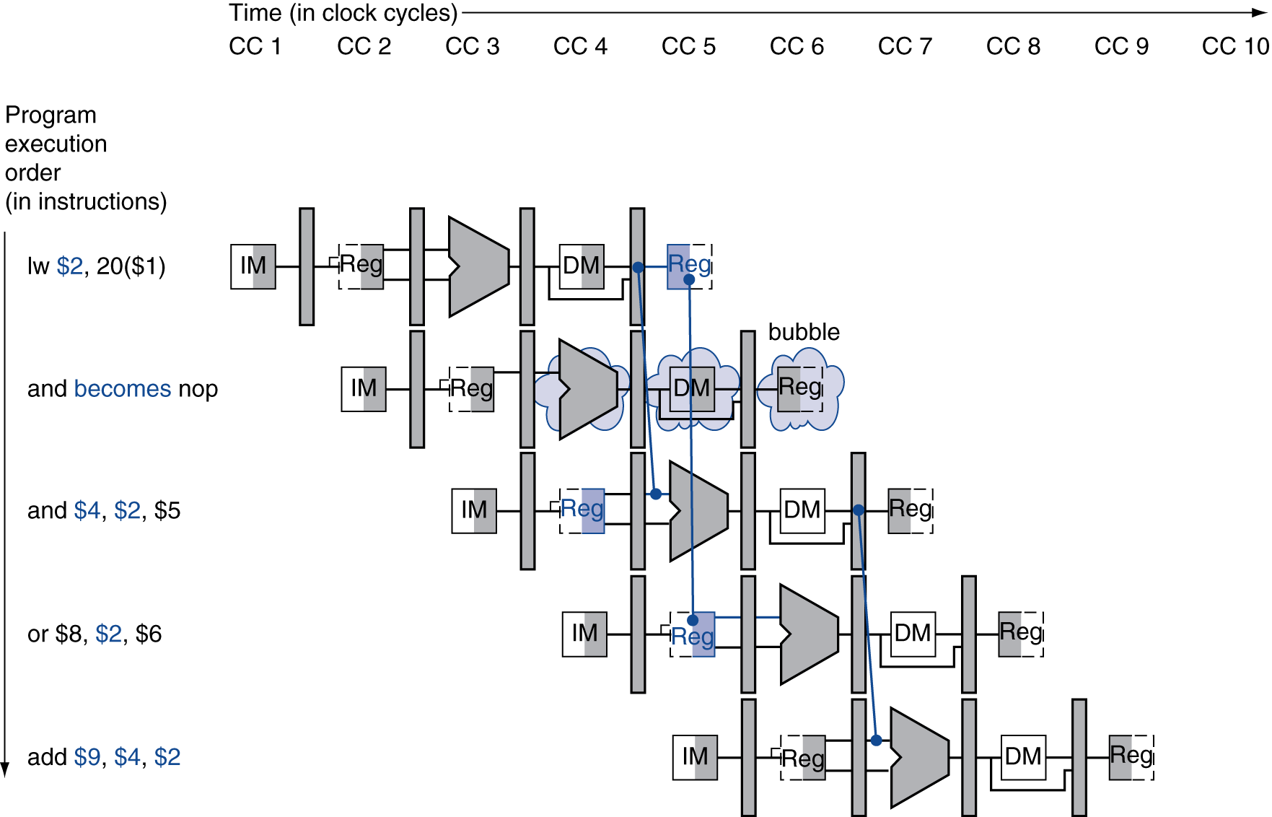
Stall/Bubble in the Pipeline
Stall inserted here

Slide 139
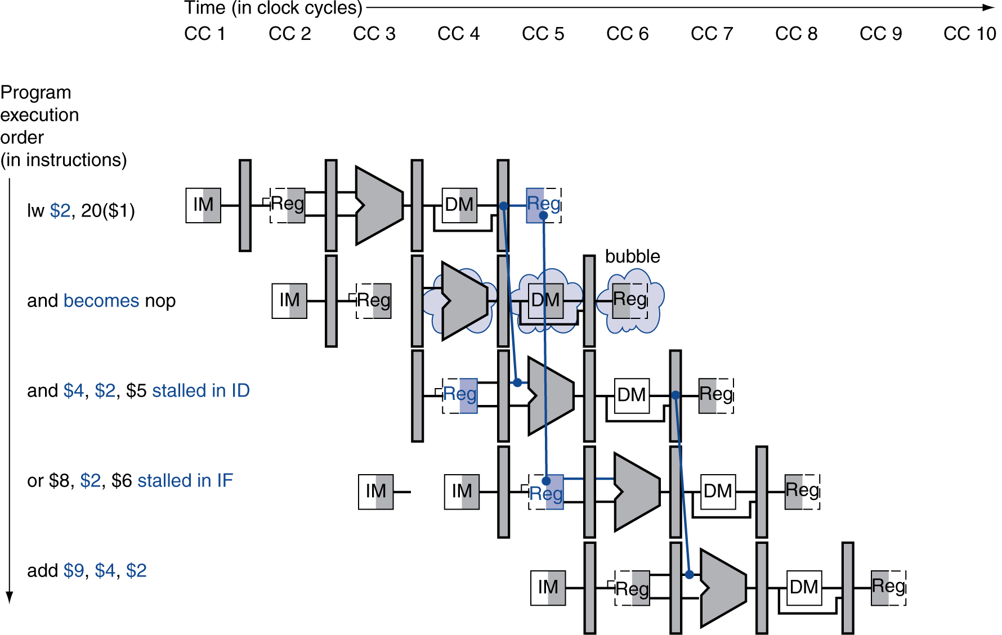
Stall/Bubble in the Pipeline
Or, more accurately…

Slide 140
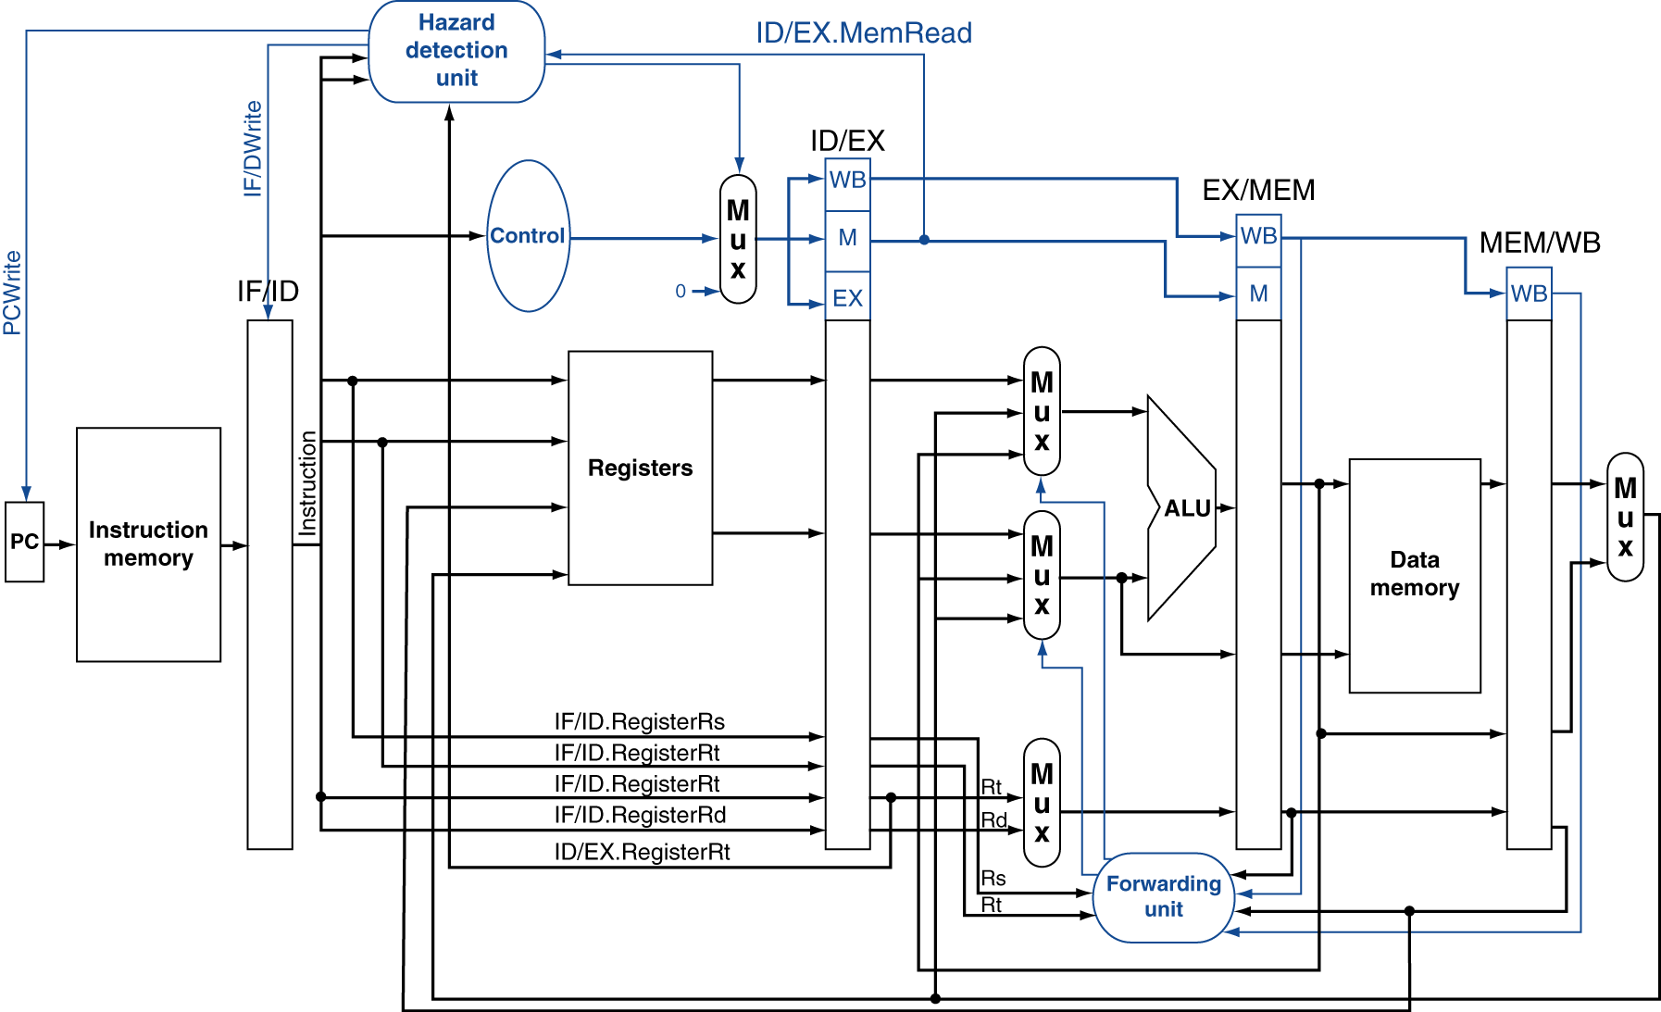
Datapath with Hazard Detection

Slide 141
Stalls and Performance
The BIG Picture
Stalls reduce performance
But are required to get correct results
Compiler can arrange code to avoid hazards and stalls
Requires knowledge of the pipeline structure

Slide 142
Branch Hazards
§4.8 Control Hazards
If branch outcome determined in MEM
Flush these instructions
(Set control values to 0)
PC

Slide 143
Reducing Branch Delay
Move hardware to determine outcome to ID stage
Target address adder
Register comparator
Example: branch taken
36: sub $10, $4, $8 40: beq $1, $3, 7 44: and $12, $2, $5 48: or $13, $2, $6 52: add $14, $4, $2 56: slt $15, $6, $7 ... 72: lw $4, 50($7)

Slide 144
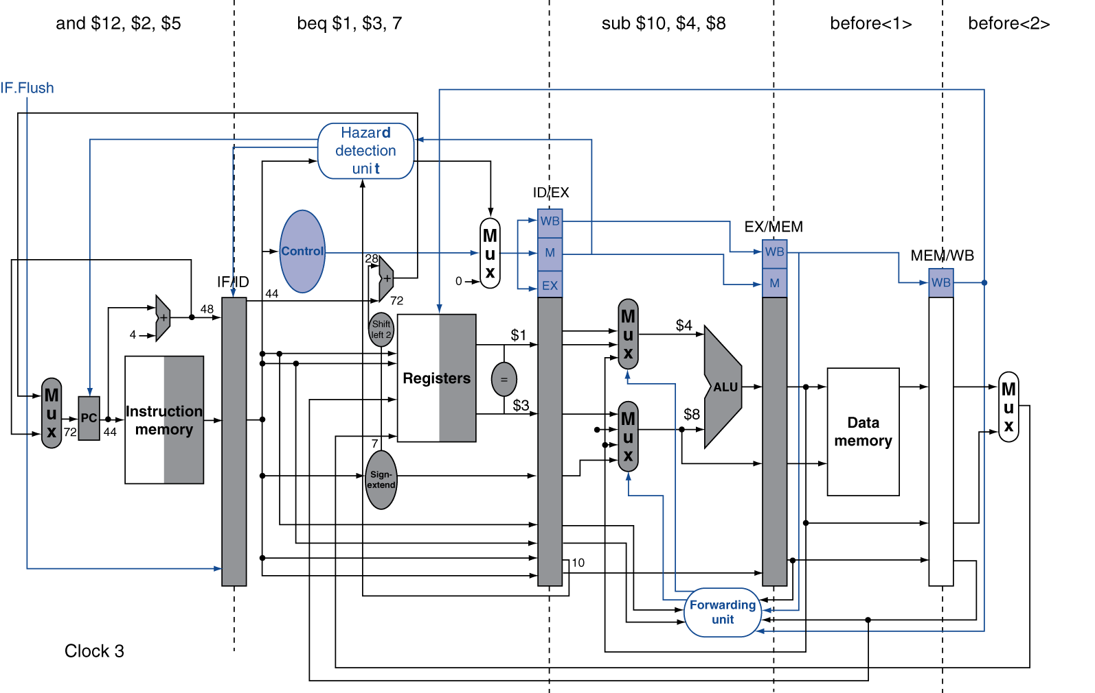
Example: Branch Taken

Slide 145
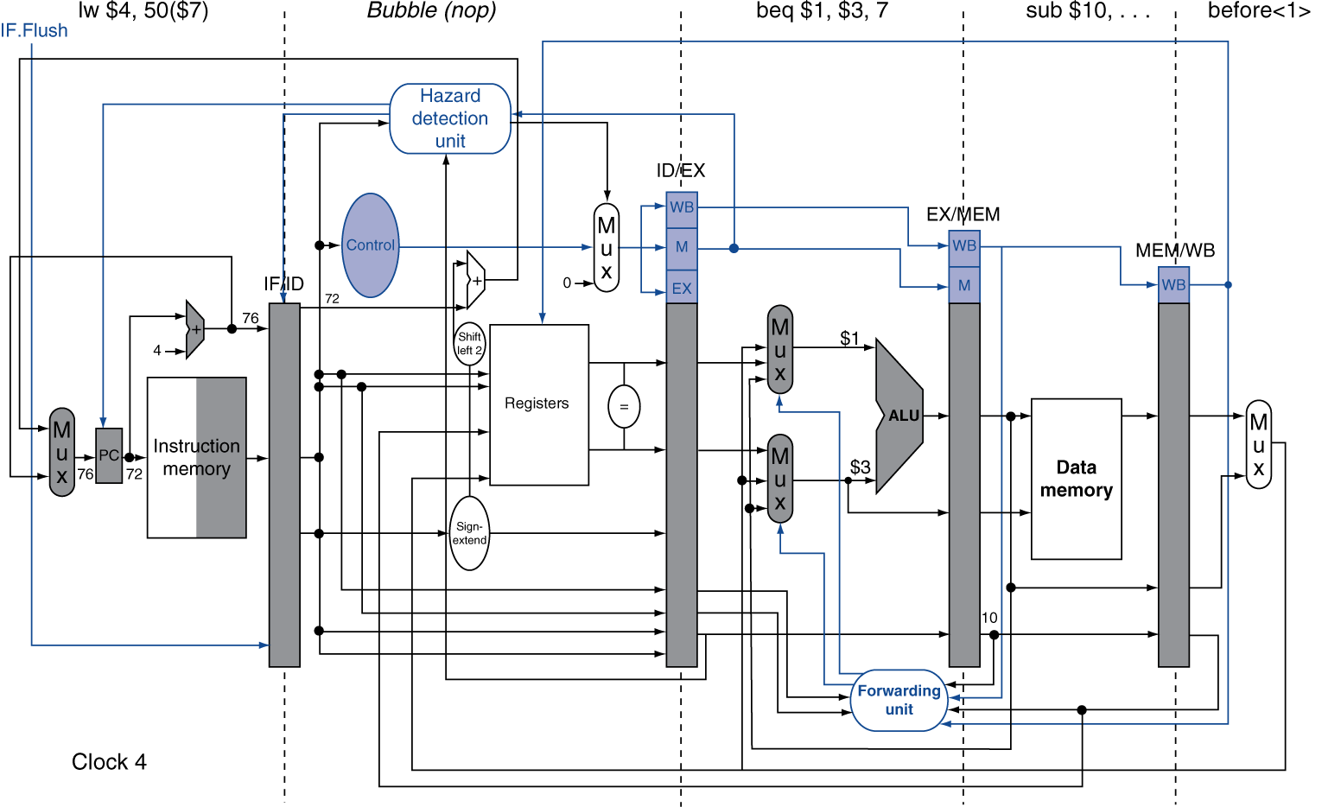
Example: Branch Taken

Slide 146
Data Hazards for Branches
If a comparison register is a destination of 2nd or 3rd preceding ALU instruction
add $1, $2, $3
IF
ID
EX
MEM
WB
add $4, $5, $6
IF
ID
EX
MEM
WB
…
IF
ID
EX
MEM
WB
beq $1, $4, target
IF
ID
EX
MEM
WB
Can resolve using forwarding

Slide 147
Data Hazards for Branches
If a comparison register is a destination of preceding ALU instruction or 2nd preceding load instruction
Need 1 stall cycle
lw $1, addr
IF
ID
EX
MEM
WB
add $4, $5, $6
IF
ID
EX
MEM
WB
beq stalled
IF
ID
beq $1, $4, target
ID
EX
MEM
WB

Slide 148
Data Hazards for Branches
If a comparison register is a destination of immediately preceding load instruction
Need 2 stall cycles
lw $1, addr
IF
ID
EX
MEM
WB
beq stalled
IF
ID
beq stalled
ID
beq $1, $0, target
ID
EX
MEM
WB

Slide 149
Calculating the Branch Target
Even with predictor, still need to calculate the target address
1-cycle penalty for a taken branch
Branch target buffer
Cache of target addresses
Indexed by PC when instruction fetched
If hit and instruction is branch predicted taken, can fetch target immediately

Slide 150
Pipeline Summary
Pipelining improves performance by increasing instruction throughput
Executes multiple instructions in parallel
Each instruction has the same latency
Subject to hazards
Structure, data, control
Instruction set design affects complexity of pipeline implementation

Slide 151
Cortex A8 and Intel i7
Processor | ARM A8 | Intel Core i7 920
Market | Personal Mobile Device | Server, cloud
Thermal design power | 2 Watts | 130 Watts
Clock rate | 1 GHz | 2.66 GHz
Cores/Chip | 1 | 4
Floating point? | No | Yes
Multiple issue? | Dynamic | Dynamic
Peak instructions/clock cycle | 2 | 4
Pipeline stages | 14 | 14
Pipeline schedule | Static in-order | Dynamic out-of-order with speculation
Branch prediction | 2-level | 2-level
1st level caches/core | 32 KiB I, 32 KiB D | 32 KiB I, 32 KiB D
2nd level caches/core | 128-1024 KiB | 256 KiB
3rd level caches (shared) | - | 2- 8 MB
§4.11 Real Stuff: The ARM Cortex-A8 and Intel Core i7 Pipelines

Slide 152
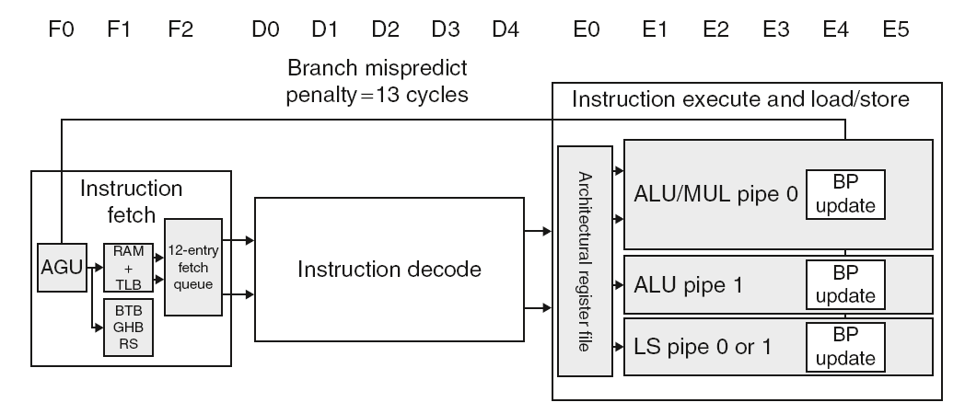
ARM Cortex-A8 Pipeline

Slide 153
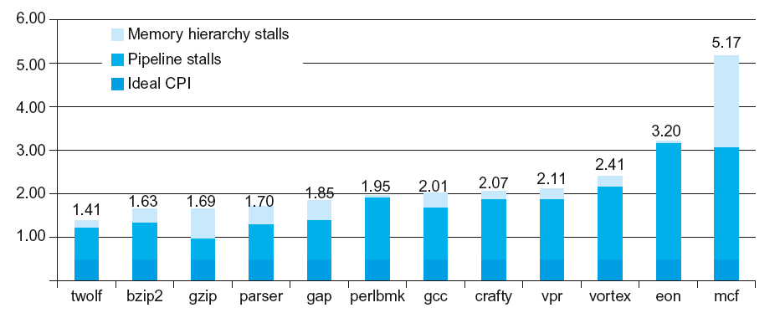
ARM Cortex-A8 Performance

Slide 154
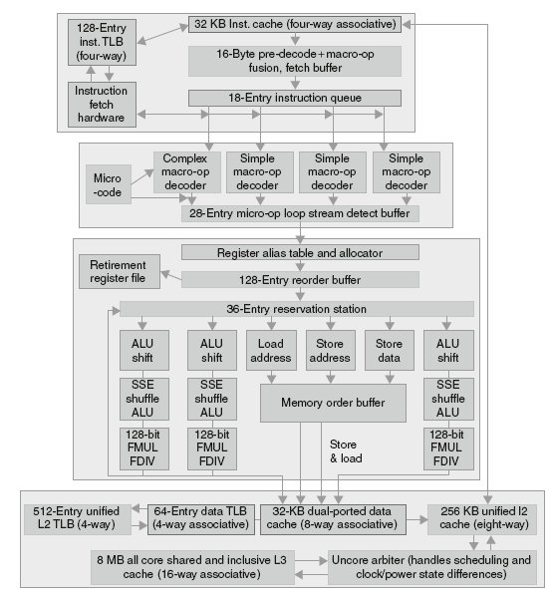
Core i7 Pipeline

Slide 155


Core i7 Performance

Slide 156
Matrix Multiply
Unrolled C code
1 #include <x86intrin.h>
2 #define UNROLL (4)
3
4 void dgemm (int n, double* A, double* B, double* C)
5 {
6 for ( int i = 0; i < n; i+=UNROLL*4 )
7 for ( int j = 0; j < n; j++ ) {
8 __m256d c[4];
9 for ( int x = 0; x < UNROLL; x++ )
10 c[x] = _mm256_load_pd(C+i+x*4+j*n);
11
12 for( int k = 0; k < n; k++ )
13 {
14 __m256d b = _mm256_broadcast_sd(B+k+j*n);
15 for (int x = 0; x < UNROLL; x++)
16 c[x] = _mm256_add_pd(c[x],
17 _mm256_mul_pd(_mm256_load_pd(A+n*k+x*4+i), b));
18 }
19
20 for ( int x = 0; x < UNROLL; x++ )
21 _mm256_store_pd(C+i+x*4+j*n, c[x]);
22 }
23 }
§4.12 Instruction-Level Parallelism and Matrix Multiply

Slide 157
Matrix Multiply
Assembly code:
1 vmovapd (%r11),%ymm4 # Load 4 elements of C into %ymm4
2 mov %rbx,%rax # register %rax = %rbx
3 xor %ecx,%ecx # register %ecx = 0
4 vmovapd 0x20(%r11),%ymm3 # Load 4 elements of C into %ymm3
5 vmovapd 0x40(%r11),%ymm2 # Load 4 elements of C into %ymm2
6 vmovapd 0x60(%r11),%ymm1 # Load 4 elements of C into %ymm1
7 vbroadcastsd (%rcx,%r9,1),%ymm0 # Make 4 copies of B element
8 add $0x8,%rcx # register %rcx = %rcx + 8
9 vmulpd (%rax),%ymm0,%ymm5 # Parallel mul %ymm1,4 A elements
10 vaddpd %ymm5,%ymm4,%ymm4 # Parallel add %ymm5, %ymm4
11 vmulpd 0x20(%rax),%ymm0,%ymm5 # Parallel mul %ymm1,4 A elements
12 vaddpd %ymm5,%ymm3,%ymm3 # Parallel add %ymm5, %ymm3
13 vmulpd 0x40(%rax),%ymm0,%ymm5 # Parallel mul %ymm1,4 A elements
14 vmulpd 0x60(%rax),%ymm0,%ymm0 # Parallel mul %ymm1,4 A elements
15 add %r8,%rax # register %rax = %rax + %r8
16 cmp %r10,%rcx # compare %r8 to %rax
17 vaddpd %ymm5,%ymm2,%ymm2 # Parallel add %ymm5, %ymm2
18 vaddpd %ymm0,%ymm1,%ymm1 # Parallel add %ymm0, %ymm1
19 jne 68 <dgemm+0x68> # jump if not %r8 != %rax
20 add $0x1,%esi # register % esi = % esi + 1
21 vmovapd %ymm4,(%r11) # Store %ymm4 into 4 C elements
22 vmovapd %ymm3,0x20(%r11) # Store %ymm3 into 4 C elements
23 vmovapd %ymm2,0x40(%r11) # Store %ymm2 into 4 C elements
24 vmovapd %ymm1,0x60(%r11) # Store %ymm1 into 4 C elements
§4.12 Instruction-Level Parallelism and Matrix Multiply

Slide 158

Performance Impact

Slide 159
Fallacies
Pipelining is easy (!)
The basic idea is easy
The devil is in the details
e.g., detecting data hazards
Pipelining is independent of technology
So why haven’t we always done pipelining?
More transistors make more advanced techniques feasible
Pipeline-related ISA design needs to take account of technology trends
e.g., predicated instructions
§4.14 Fallacies and Pitfalls

Slide 160
Pitfalls
Poor ISA design can make pipelining harder
e.g., complex instruction sets (VAX, IA-32)
Significant overhead to make pipelining work
IA-32 micro-op approach
e.g., complex addressing modes
Register update side effects, memory indirection
e.g., delayed branches
Advanced pipelines have long delay slots

Slide 161
Concluding Remarks
ISA influences design of datapath and control
Datapath and control influence design of ISA
Pipelining improves instruction throughput using parallelism
More instructions completed per second
Latency for each instruction not reduced
Hazards: structural, data, control
Multiple issue and dynamic scheduling (ILP)
Dependencies limit achievable parallelism
Complexity leads to the power wall
§4.14 Concluding Remarks

